Slide 1
How to Give a
Chalk Talk
Clinician Educator Curriculum
Lecture 2:
Jay Kachoria, MD
November 4, 2020

Slide 2
Learning Objectives
Learners should be able to:
Condense the presentation to a short time period
Create teaching scripts and diagnostic schemas
Guide the presentation through the Socratic method
Adapt the talk to the level of the learner
Notes:
Emphasize the importance of being succinct to a successful chalk talk
Teaching scripts and diagnostic schemas help us organize our thinking for a meaningful chalk talk
Increase participation and allow learners to identify their own knowledge gaps
Adapt the talk based on who you are giving it to and allow it to improve with each iteration

Slide 3
What is a Chalk Talk?
Off-the-cuff teaching relevant to current patient care using paper or a white/chalk board to discuss a topic.
Notes:
Importantly:
Topic in regards to something relevant to current patient care
Uses paper or white/chalk board
Don’t use prepared slides

Slide 4

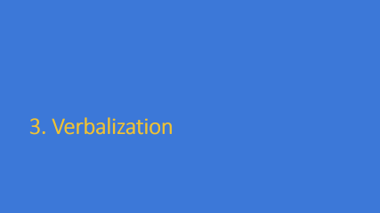

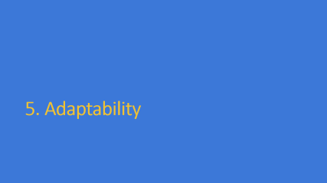
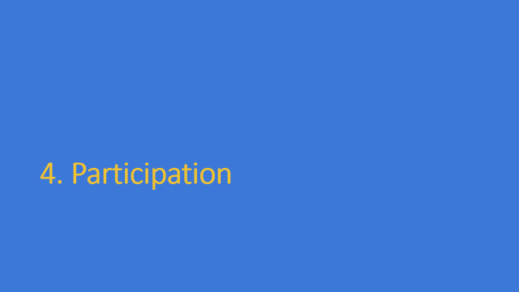







Overview
Notes:
These are what I think are the fundamentals to creating a good chalk talk.
We’ll go through each one of these with more detail.

Slide 5
1. Timeliness
Notes:
To emphasize how important timeliness is to a chalk talk, we’ll start with that.

Slide 6
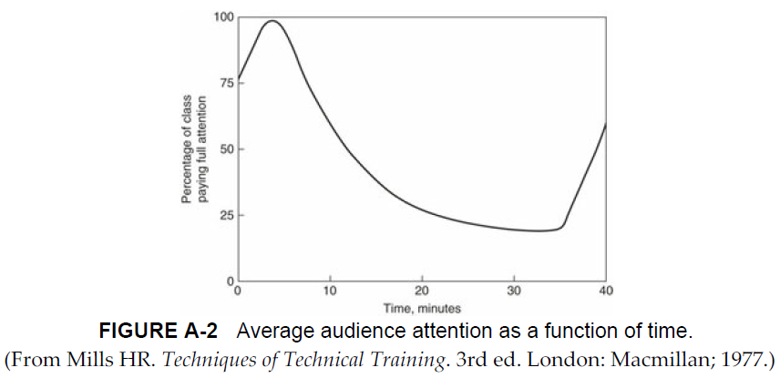
Timeliness
<20-30 minutes
Notes:
20-30 minutes to keeps the learners engaged.
Anything more than that is likely to have diminishing returns. I bring this up first, as opposed to topic, structure, engagement, etc., to emphasize the importance of timing on a chalk talk.
Unlike morning reports (which can go for 45 minutes to an hour), a chalk talk should be succinct by design.

Slide 7
Timeliness
Redirect the discussion to stay within the time frame
Strong leadership
Notes:
Part of being timely is understanding hurdles that can come up.
Conversation can often have tangents. Answer necessary points though redirect the conversation back to the relevant topic. If necessary, make it a point to discuss other questions that may have come up in another chalk talk.
With a larger group, strong leadership will be required to keep the learners engaged but also to keep the talk succinct

Slide 8
Overview

Slide 9
2. Relevance
Notes:
Now that we have the time limit out of the way, let’s focus on what are we actually going to talk about.

Slide 10
Relevance
Focus on active problems in patients currently being cared for
Talk should be relevant to a wide group of people
Best to focus on “hard” findings in medicine
Notes:
The talk should be centered around something relevant to a patient you are currently taking care of. For the learners, the proximity to an actual case helps solidify the learning points.
The topic should not be so focused to only be relevant to one particular patient or case. The topic should be generalizable to multiple scenarios or patients.
Instead of focusing on cutting-edge research or new-age medicine, better to focus on concrete topics that have lots of foundational evidence. New biologics vs anemia diagnosis

Slide 11
Relevance
55y M, IVDU, presenting with fever, tachycardia, and leukocytosis and pending blood cultures, started on IV antibiotics.
Diagnosis and management of sepsis
Endocarditis
Antibiotic therapy
Opiate withdrawal management
Notes:
Practice adult patients:
This patient has one primary problem but there are still many things to talk about that stem from that primary problem. None of these topics are so nuanced to hardly ever come up again. Consequently, learning about these topics is invaluable to learners as it will be relevant to later patients.

Slide 12
Relevance
15mo M, unvaccinated, admitted to the hospital with influenza incidentally found to be anemic likely related to significant cow’s milk consumption.
Vaccine-preventable illnesses
Anemia
Pediatric nutrition
Notes:
Pediatric example:
Alright how about you all try. Think of a few topics that could be discussed as a chalk talk from this case.
None of these topics are so nuanced to not be relevant later to another patient we may be taking care of later that week.

Slide 13
Relevance
Any other ideas for good chalk talks?
Asthma step-up therapy
Cyanotic heart disease
IBD management
Management of fever in a baby
Eczema management
Notes:
Audience poll: other good ideas for chalk talks?

Slide 14
Overview

Slide 15
3. Verbalization
Notes:
Given a relevant topic, how do we go about structuring a talk to fit the time constraints?

Slide 16
Verbalization
Start presentation with learning objectives
Balance of talking and writing: majority of talk should be spoken
  Chalk/white board serves as a way to highlight certain key points
  Writing provides a literal “take-away”
Notes:
Having learning objectives at the start of a talk provides learners with a frame of reference of what they’ll be learning
Given the time constraints of writing, there should be a careful balance of writing and talking with emphasis on talking.
Engages learners in the discussion making them actively involved
Similar to any presentation, the writing should serve as a topic of discussion
Writing things down serves to highlight key points and provide a visual scaffolding upon which learners can anchor their own understanding
Often the most important take-away from a chalk-talk is a literal take-away that learners can take a picture of or make a copy of to refer back to later and consolidate their learning

Slide 17
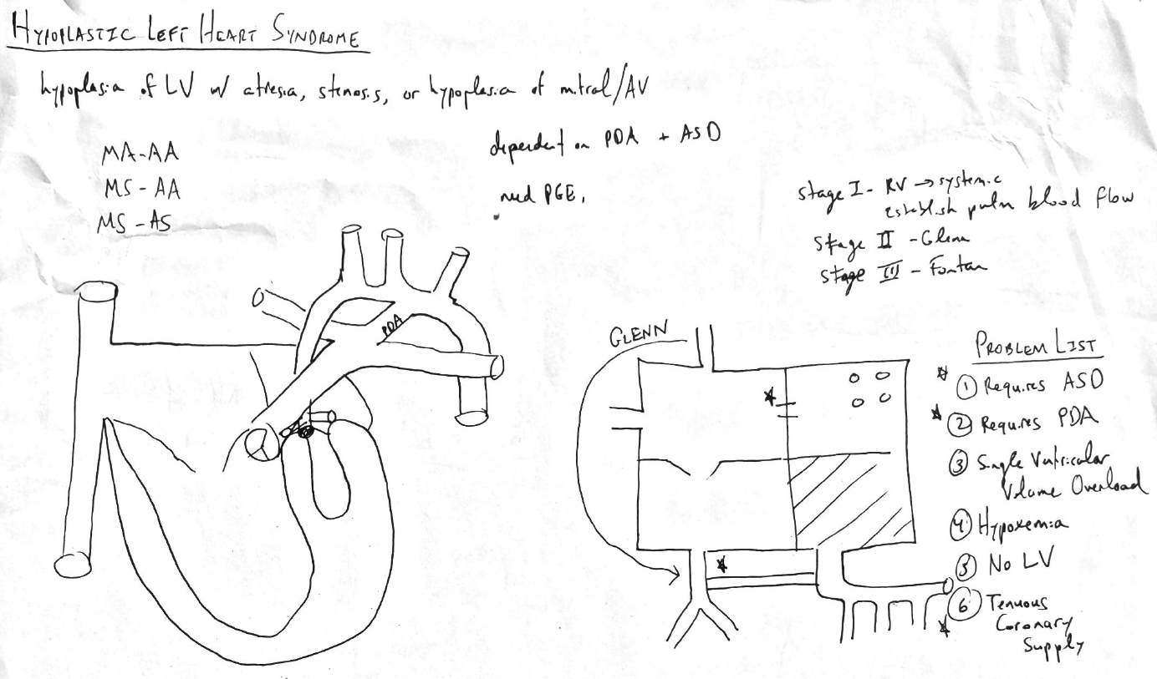
Verbalization (examples)

Slide 18
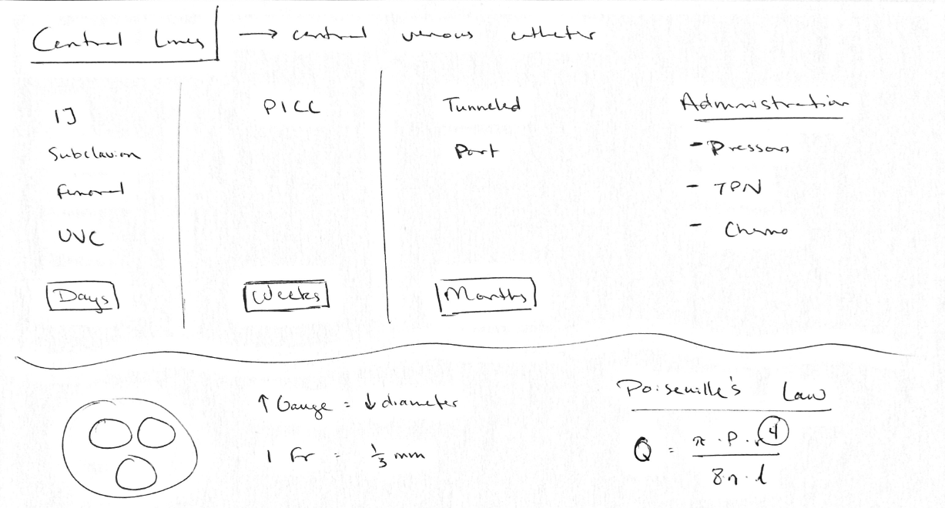
Verbalization (examples)

Slide 19
Verbalization
Start presentation with learning objectives
Balance of talking and writing: majority of talk should be spoken
  Chalk/white board serves as a way to highlight certain key points
  Writing provides a literal “take-away”
Focus on teaching scripts and diagnostic schemas
Notes:
Having learning objectives at the start of a talk provides learners with a frame of reference of what they’ll be learning
Given the time constraints of writing, there should be a careful balance of writing and talking with emphasis on talking.
Engages learners in the discussion making them actively involved
Similar to any presentation, the writing should serve as a topic of discussion
Writing things down serves to highlight key points and provide a visual scaffolding upon which learners can anchor their own understanding
Teaching scripts and diagnostic schemas serve as preparation prior to your talk to make it more effective

Slide 20
Teaching Scripts – Planning out the talk
SOHM Library – Pediatric Teaching Scripts
Blank template to help create a script for what you will say
In response to specific knowledge gap “triggers”
Notes:
Pediatric resource for creating teaching scripts and forming the basis of your talk
They provide a template upon which you can structure your talk and prepare.
Specifically, they start off with “triggers” which are knowledge gaps you’ve identified in learners

Slide 21
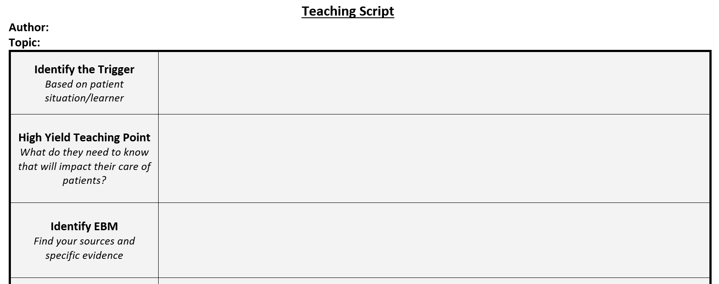
Teaching Scripts – SOHM Library
What was the knowledge gap?
What are the key take-aways or learning objectives?
Primary sources
UpToDate
Dynamed
Notes:
Going through what the document entails, part 1

Slide 22
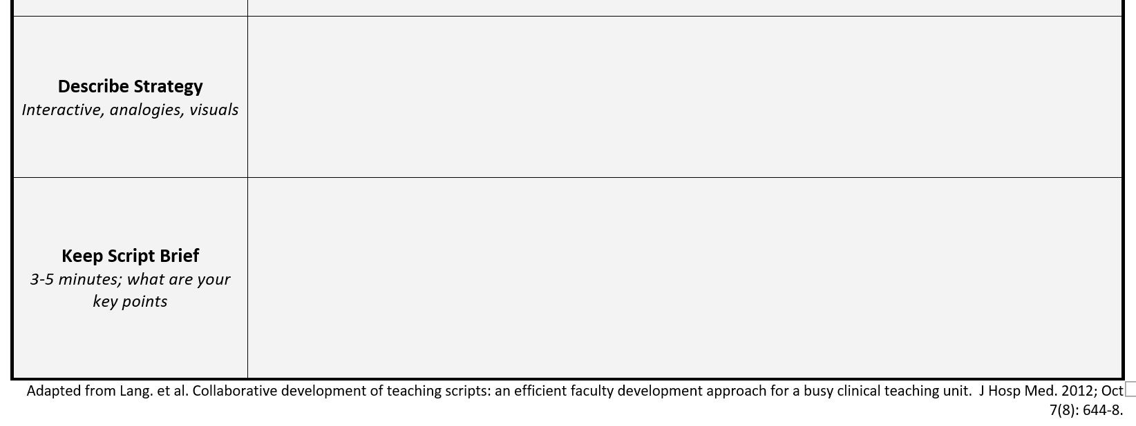
Teaching Scripts – SOHM Library
Outline
Web association
Table
Create the “scaffolding” of your talk
Notes:
Going through what the document entails, part 2

Slide 23
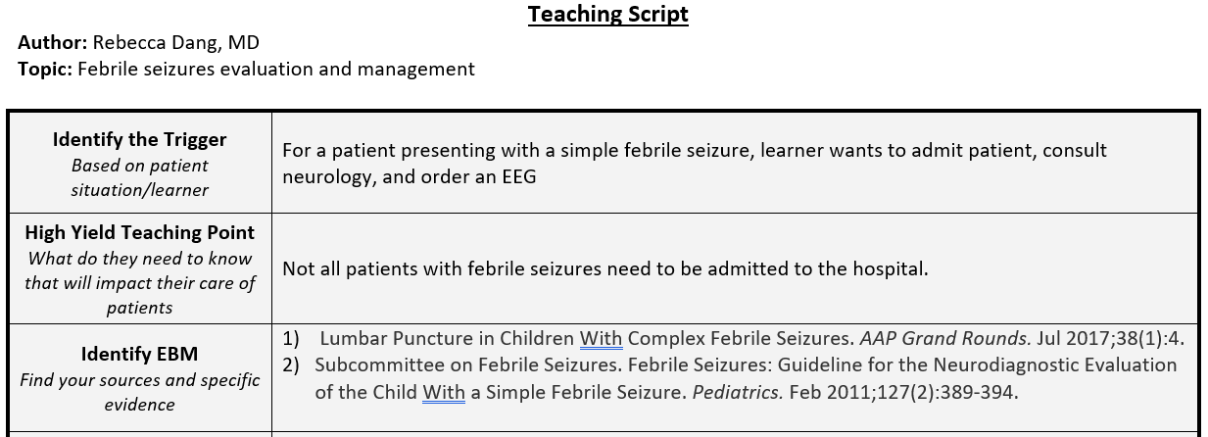
Teaching Scripts – SOHM Library (example)
Notes:
Going through what the document entails, part 2

Slide 24
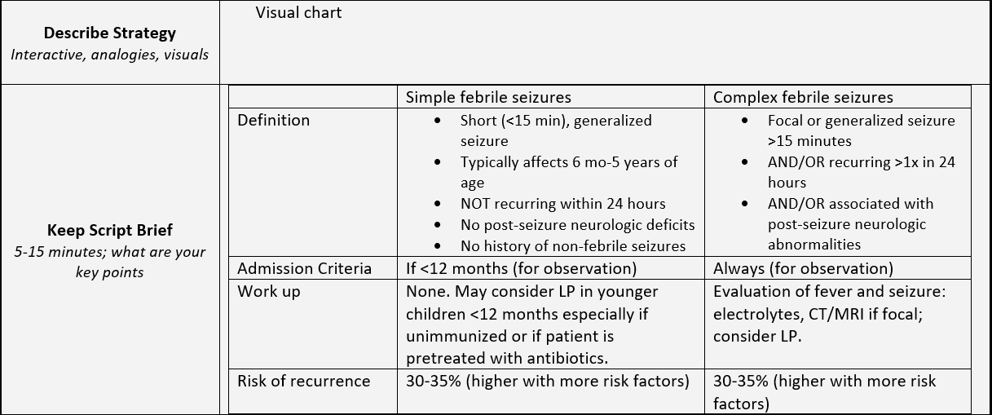
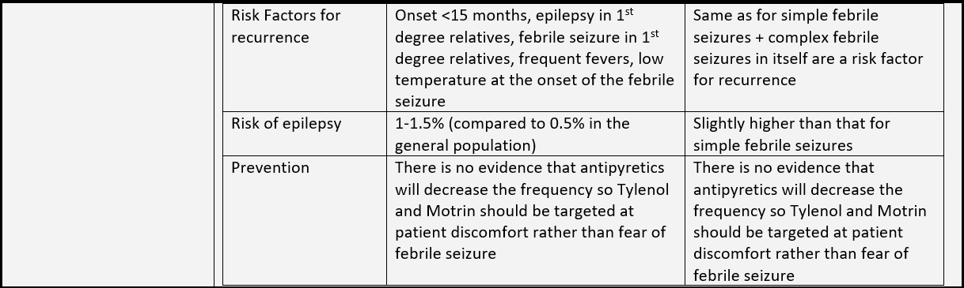
Teaching Scripts – SOHM Library (example)
Notes:
Going through what the document entails, part 2

Slide 25
Diagnostic Schemas – Planning out the talk
Clinical Problem Solving – Medicine Diagnostic Schemas
Pre-made “scaffolding” for common medicine topics
Notes:
Clinical Problem Solvers serve as a resource to “jump start” some of the visuals for a talk. Helps conceptualize a topic and the best way to deliver the information.

Slide 26
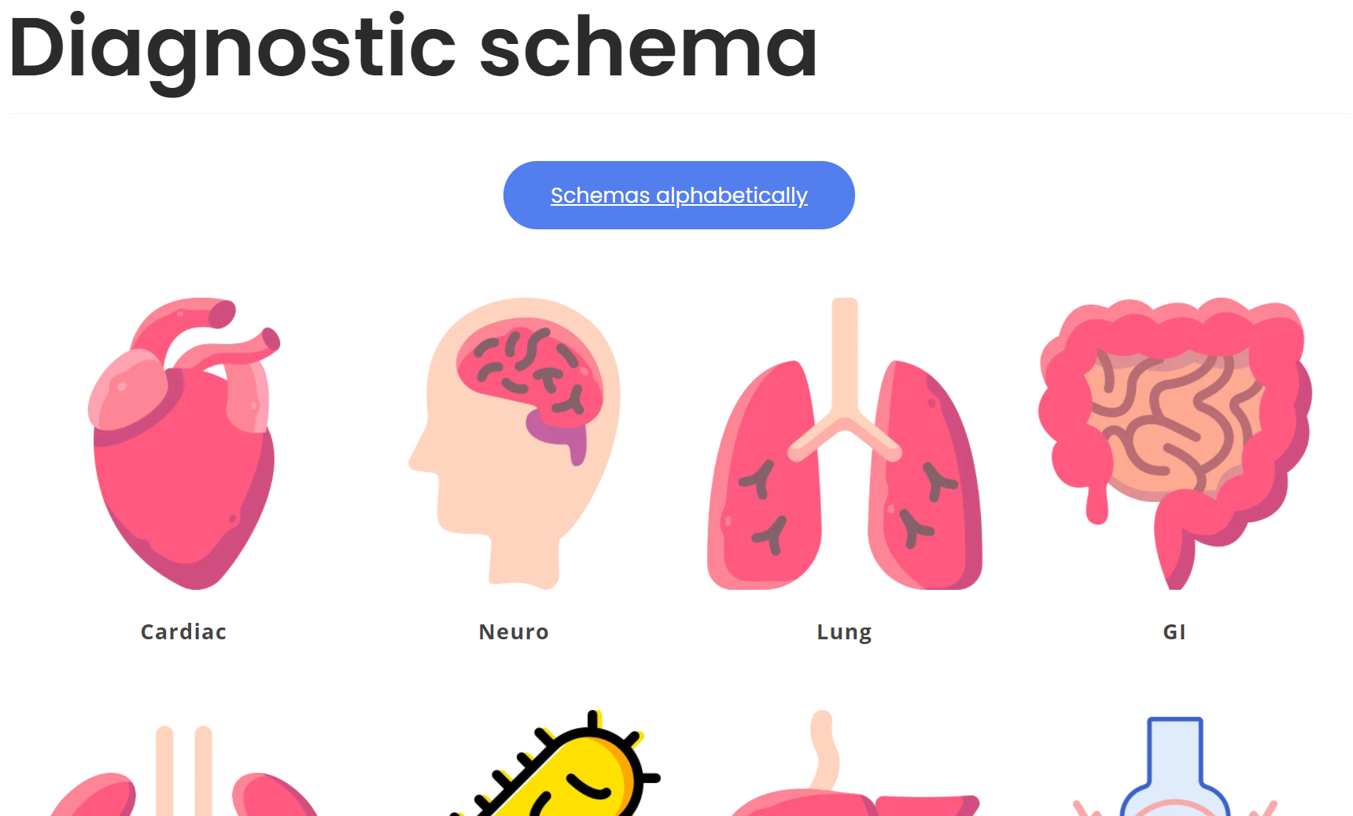
Diagnostic Schemas – Clinical Problem Solving
Serves as a good jumping off point
Notes:
Example:
- Picking the cardiac section at their website

Slide 27
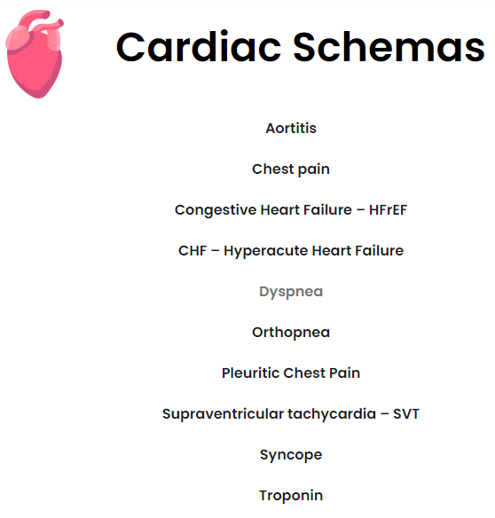
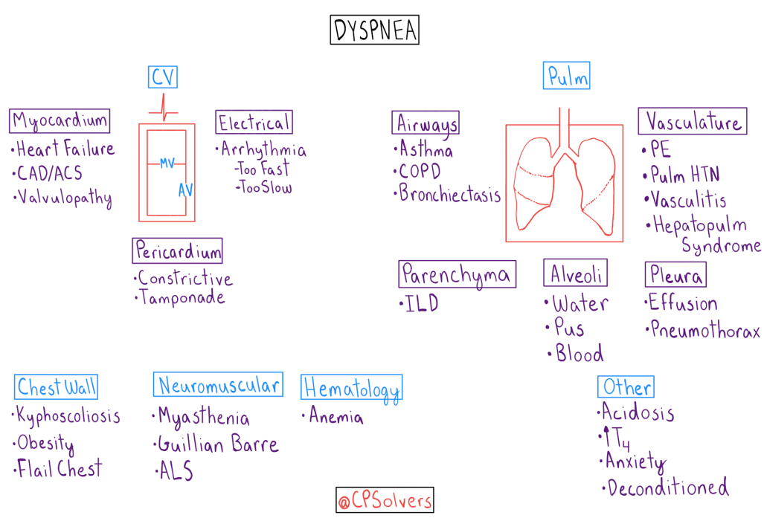
Diagnostic Schemas – Clinical Problem Solving
Notes:
Clicking Dyspnea within cardiac provides a visual differential

Slide 28
Overview

Slide 29
4. Participation
Notes:
So if we know what we’re going to talk about, how we’re going to structure our talk, and how long we want it to run for, how do we get the learners to be engaged and actually get something out of the talk?

Slide 30
Participation
Extract bulk of discussion from the audience
Ask questions to have learners fill in the gaps
  Assign tasks/pre-reading
Socratic method to have learners involved
  Continual questions until a contradiction is exposed
  Develop critical thinking skills
Notes:
When I said that the majority of the chalk talk should be verbal, I meant that the learners should be doing more of the talking. This is where going back to that first bullet point, timeliness, is important because it requires strong leadership to ask questions, have the learners do the majority of the talking, and still guide the conversation in the direction you want it to go.
Asking questions serves as a great way to spur conversation. Specifically, assigning pre- or post-reading can help engage learners
Once they commit to an answer, using the Socratic method and playing Devil’s advocate can help refine their understanding. Exposing a knowledge gap through questioning allows the learner to identify their own knowledge gap

Slide 31
Participation – Types of Questions
Test the water
  “How comfortable do you feel explaining the causes of hyponatremia?”
  “How comfortable do you feel with your antibiotic stewardship?”
Clinical Scenario
  “How would you approach this patient with worsening work of breathing?”

Slide 32
Participation – Types of Questions
Direct medical questions
  “How do we define sepsis?”
Framework questions
  “How do you divide up the different causes of AKI?”
Notes:
Example questions to spur discussion

Slide 33
Overview

Slide 34
5. Adaptability
Notes:
Once you’ve given your talk a couple of times, how do you change the talk based on the audience or the specific case/patient it may be in reference to?

Slide 35
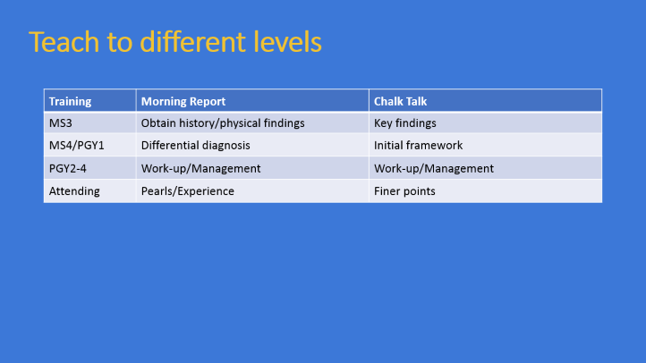

Adaptability
Adaptable based on the audience you are presenting to
Notes:
The talk should always be adaptable to the level of the learner. I’m going to borrow a slide from John Ryan’s talk on Morning Reports.

Slide 36
Teach to different levels
Training | Morning Report | Chalk Talk
MS3 | Obtain history/physical findings | Key findings
MS4/PGY1 | Differential diagnosis | Initial framework
PGY2-4 | Work-up/Management | Work-up/Management
Attending | Pearls/Experience | Finer points
Notes:
Similar to Morning Report where the level of the learner helps identify what you’ll be expecting, chalk talks have a similar framework.
MS3 should know the pathognomonic signs of certain clinical presentations
MS4/PGY1 should be able to initiate the framework
PGY2-4 provide more details to the framework, next steps, and management
Attending finer points and details

Slide 37
Overview

Slide 38
6. Completeness
Notes:
Final touches

Slide 39
Completeness
Should have a beginning and an end
  Should start and end with learning objectives
Self reflection
  What went well?
  When was/wasn’t the audience engaged?
Feedback to improve
Notes:
Start and end with learning objectives to serve as book ends to the talk
Reflect on how the talk could be improved and solicit feedback if appropriate from the learners
Can be continual through the talk: “does that make sense?”

Slide 40
Overview
Timeliness
Relevance
Verbalization
Participation
Adaptability
Completeness

Slide 41
Final Tips
Embrace your own knowledge gaps
Preparation ahead of time makes for a better talk
Allow the talk to be more conversational as oppose to scripted
Making a judgment-free zone allows learners to be more engaged
Practice making a “take-away”
Notes:
It’s okay to say I don’t know. I think it makes the chalk talk more interesting and allows you to bolster your talk the next time you give it.
Having evidence to base your talk off of makes for a better talk.
This allows learners to be more engaged
Same as above
In my experience, this has been one of the more helpful things I do for learners as it allows for consolidation on their own time.

Slide 42
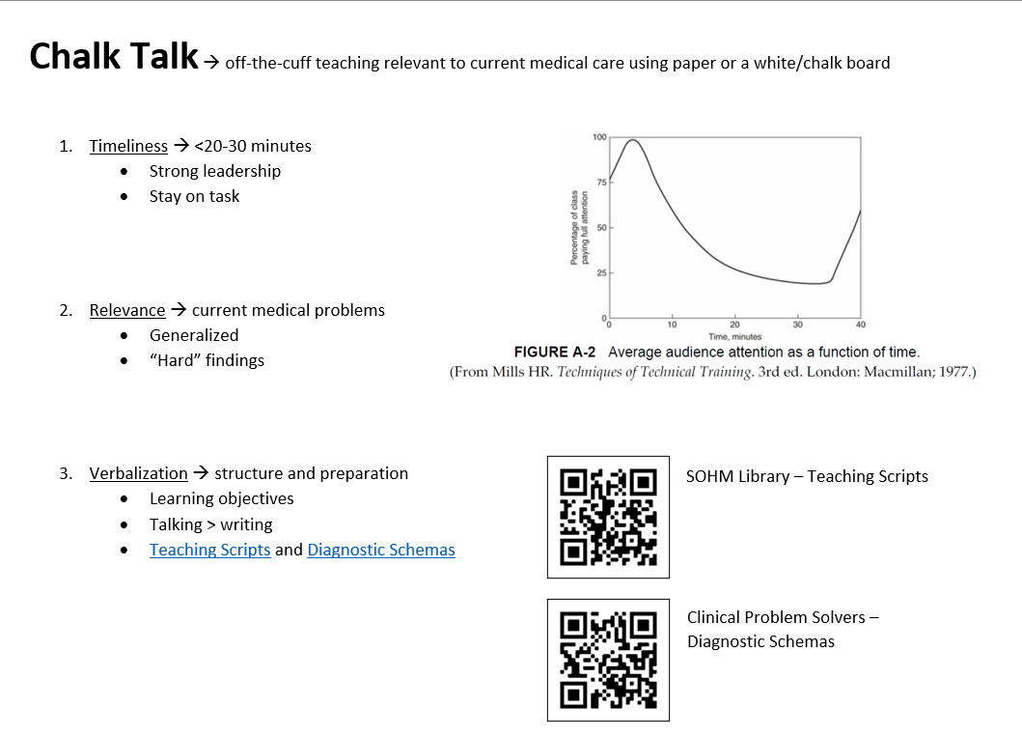

Slide 43
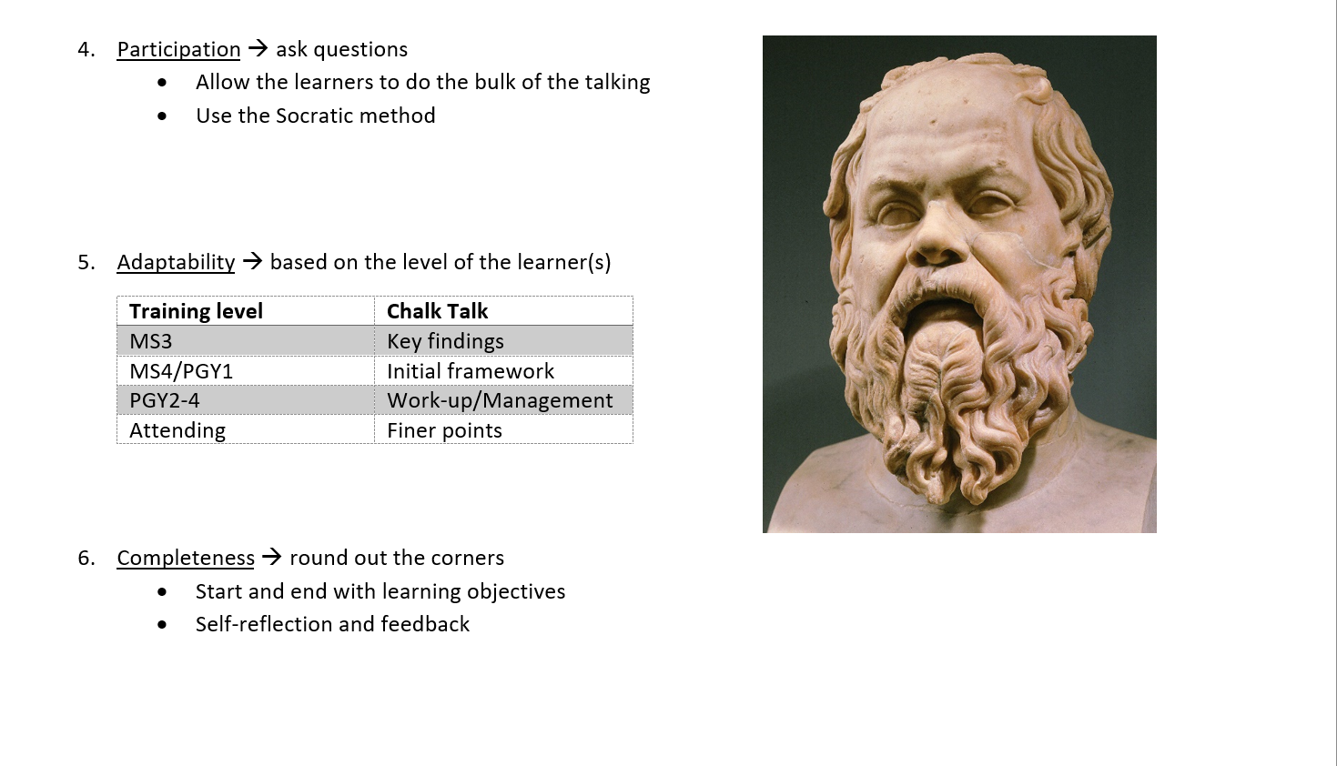

Slide 44
Questions?

