Slide 1
Procedural Teaching
Clinician Educator Curriculum
Lecture 5:
Harun Thimmiah, MD MS MA
Special thanks to Drs. Mike Fahey and Reid Evans
June 28, 2021

Slide 2
Learning Objectives
Learners should be able to:
Identify the phases of procedural teaching
Adjust your approach to procedural teaching based on phase of learning
Create an objective list to outline a specific procedure
Provide effective feedback during and post-procedurally
Define and foster experiential learning theory

Slide 3
“Tell me and I will forget, show me and I may remember, involve me and I will understand.” - Confucius
SEE ONE, DO ONE, TEACH ONE
Notes:
The power of procedural teaching can be brought back to this quote
Instead, this is the quote I hear more often and in my experience, it has never really went like this. Rarely during procedural teaching, will you have a list of steps. It is actually a see one, do one, teach one experience.

Slide 4
What is Procedural Teaching?
Using lists, visuals/videos, and repetition to effectively teach and prepare learners to perform procedures safely, competently, and successfully
Notes:
It is NOT see one, do one, teach one

Slide 5
Why do we care about Procedural Teaching?
Benjamin Bloom (1985): Developing Talent in Young People
- Retrospective look at elite performers (music, arts, mathematics)
- No correlation with IQ, only height and body type for sports
- All had practice intensively and studied with devoted teachers
K Anders Ericsson: Deliberate Practice Theory
The Cambridge Handbook of Expertise and Expert Performance (2018)
Study of experts in variety of domains: surgery, acting, chess, writing, ballet, music, etc
- “Experts are made, not born”
- Not just practice, but deliberate practice beyond level of comfort
Notes:
Most types of tradition expertise in competitives areas requires years and decades of extended efforts to improve in order to acquire mechanisms mediating world class performance
Generalizable insights ideal training environments with teachers and coaches, to fostering motivation by providing emotional and

Slide 6
Common Pediatric Procedures
MSK reductions: Nursemaid’s elbow, patellar dislocation
Peripheral IV placement
Immunizations
Suturing Lacerations: simple and complicated
Foreign body removal
Bedside ultrasound (cardiac, gallbladder, FAST, etc.)
Incision and Drainage of Abscess
Lumbar Puncture
Arterial line placement
Central venous catheter placement
NICU: UVC, UAC
Intubation
Intraosseous catheter placement
Notes:
Ask the audience what are some common pediatric procedures

Slide 7
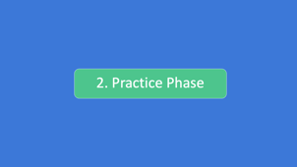

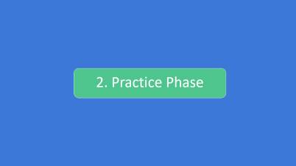



Phases of Procedural Training
Notes:
There are 3 phases

Slide 8
1. Introductory Phase

Slide 9
Introductory Phase
Participation
Provide a skills checklist
Consider video and visuals
Commit steps to memory
Notes:
Intro phase involved 3-4 components depending on the procedure

Slide 10
Introductory Phase
Participation
Provide a skills checklist
Consider video and visuals
Commit steps to memory

Slide 11
Participation – Types of Questions
Needs Assessment
  “What are your experiences with lumbar punctures?”
  “What do you know about a FAST scan?”
Clinical Scenario
  “What are some techniques for hemostasis in a patient with an oozing central venous catheter site?”
Notes:
We all know that being talked at is the most tedious way of learning and usually is ineffective
So getting your learner involved immediately is a tenet of all these talks
By eliciting participation prior to a procedure, you can prevent from teaching skills they already know and also modify your teaching based on prior knowledge
Needs assessment or Test the water questions – gets an large net and pulls in their previous knowledge
Once you get the initial needs assessment, you may progress to a clinical scenario (perfecting phase)

Slide 12
Participation – Types of Questions
Direct medical questions
  “What are the contraindications for a lumbar puncture?”
Framework questions
  “How do you interpret CSF cell counts, protein, and glucose?”
Notes:
You can also ask direct medical questions or framework questions for a more advanced learner, someone who is not in the introductory phase but in practice or perfecting phases
Coincidentally, someone may be well versed in the knowledge, but no history in a procedure
Examples are

Slide 13
Introductory Phase
Participation
Provide a skills checklist
Consider video and visuals
Commit steps to memory
Notes:
Provide a skills checklist, essentially what this is is a procedure that is written out that a learner can follow along
It is not only helpful when the learner is in the introductory phase, but also the other two phases to refer back
It’s important to keep this concise and
elaborate on finer points during the procedure

Slide 14
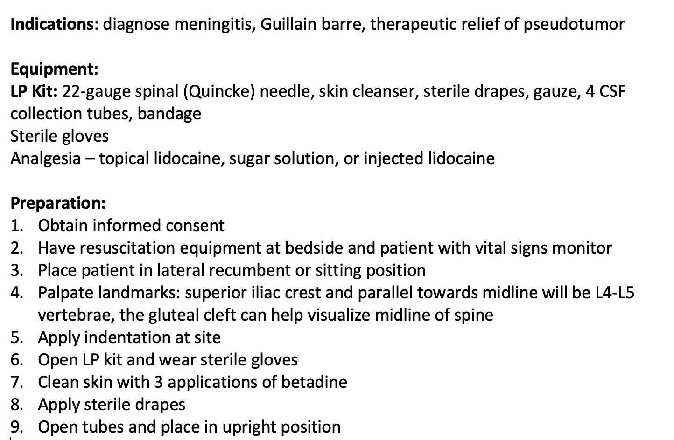
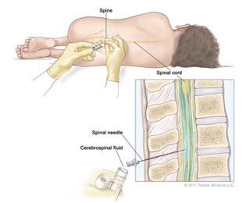
Skills Checklist (Lumbar Puncture)
Notes:
Remember, this has to be kept concise or the learner may get intimidated by small details
Here’s an example of a skills checklist that I made for an LP, this fits on one page
It includes visuals
Ask yourself, could you perform this procedure by following these steps?
Avoids missing steps that are second nature to you
Send to a friend to see if there’s anything missed
You'll notice, there are some details that can be elaborated on during the procedure
7 - clean skin in "concentric fashion, starting from middle
8, apply sterile dressing can be explained during procedure

Slide 15
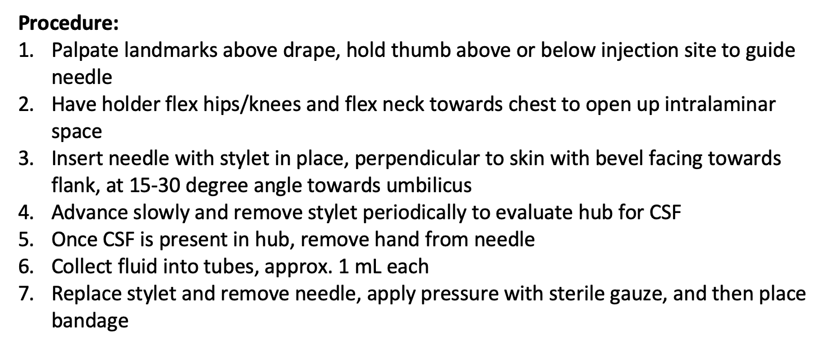
Skills Checklist (Lumbar Puncture)
Notes:
Finer details during procedure:
3. may feel pop when progressing needle
3. bevel certain direction to intersect fibers

Slide 16
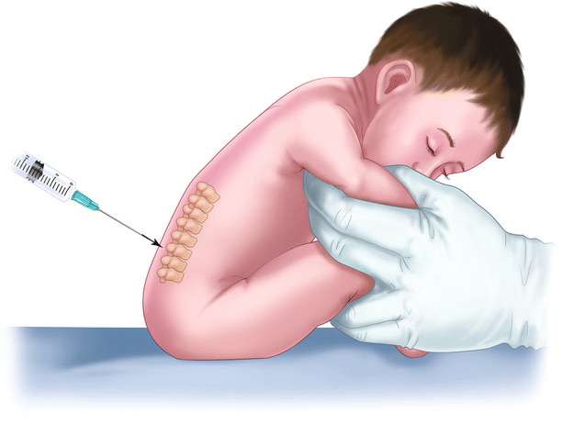
Introductory Phase
Participation
Provide a skills checklist
Consider visuals and/or videos
Commit steps to memory
Notes:
The next part of the intro phase is visuals or videos
Here is an upright LP being performed

Slide 17
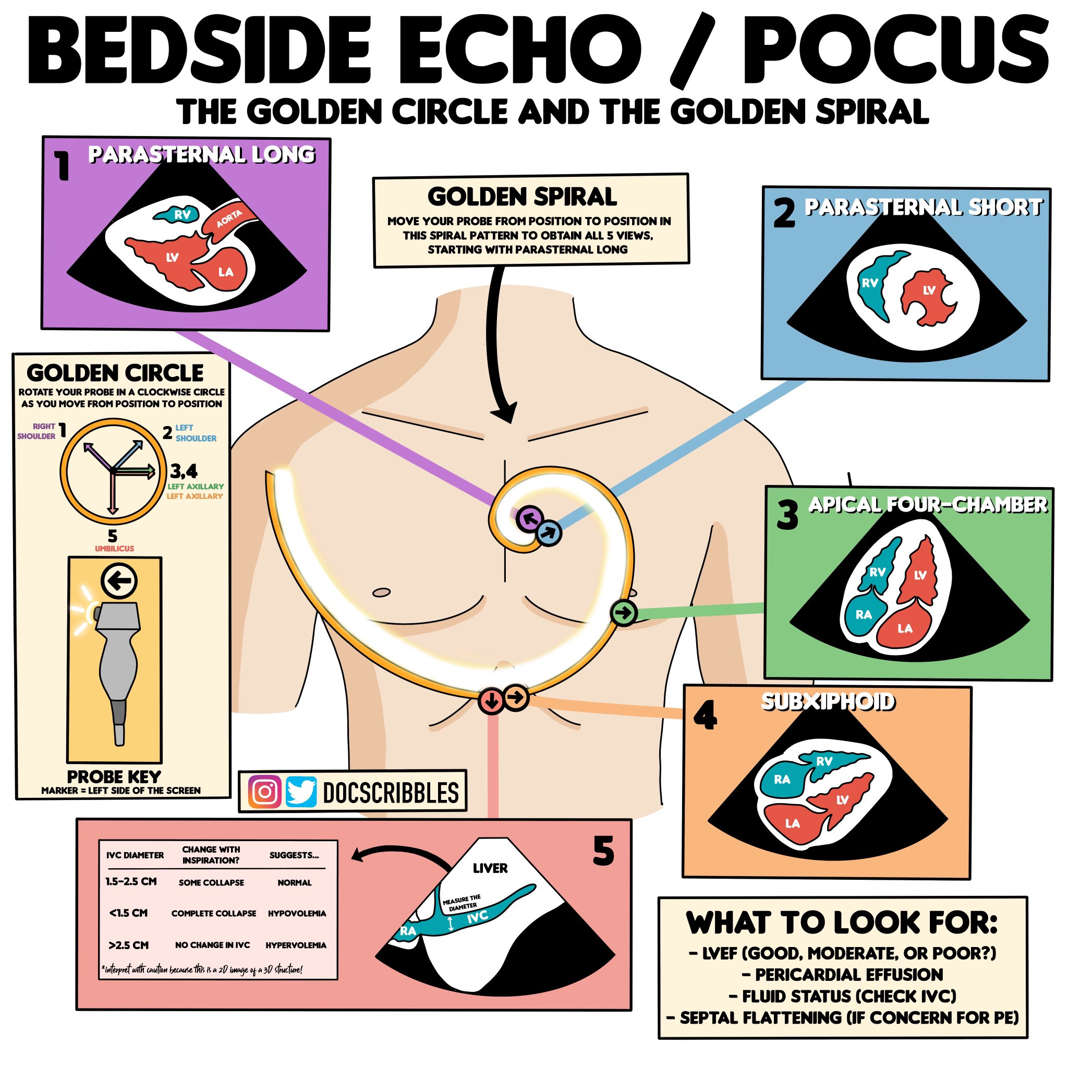
Visuals
Notes:
In some scenarios, you may just need a visual and not a skills checklist
Other times, a procedure may arise quickly and a visual will help orient the learner
Some procedures where this may be the case are:
Simple sutures, immunizations, MSK reductions, foreign body removal, and occasionally bedside ultrasound
You can also think simulation, in the ED, a patient with a seizure or asthma exacerbation where you know the algorithm pat down, but the learner with you may not. Similarly in codes.
Here’s an example of the visual I have on my phone to walk through a bedside echo
Keep in mind, I’m not calculating pressures or looking for minute details
A quick assessment of EF, pericardial effusion/tamponade, IVC, IV septum

Slide 18
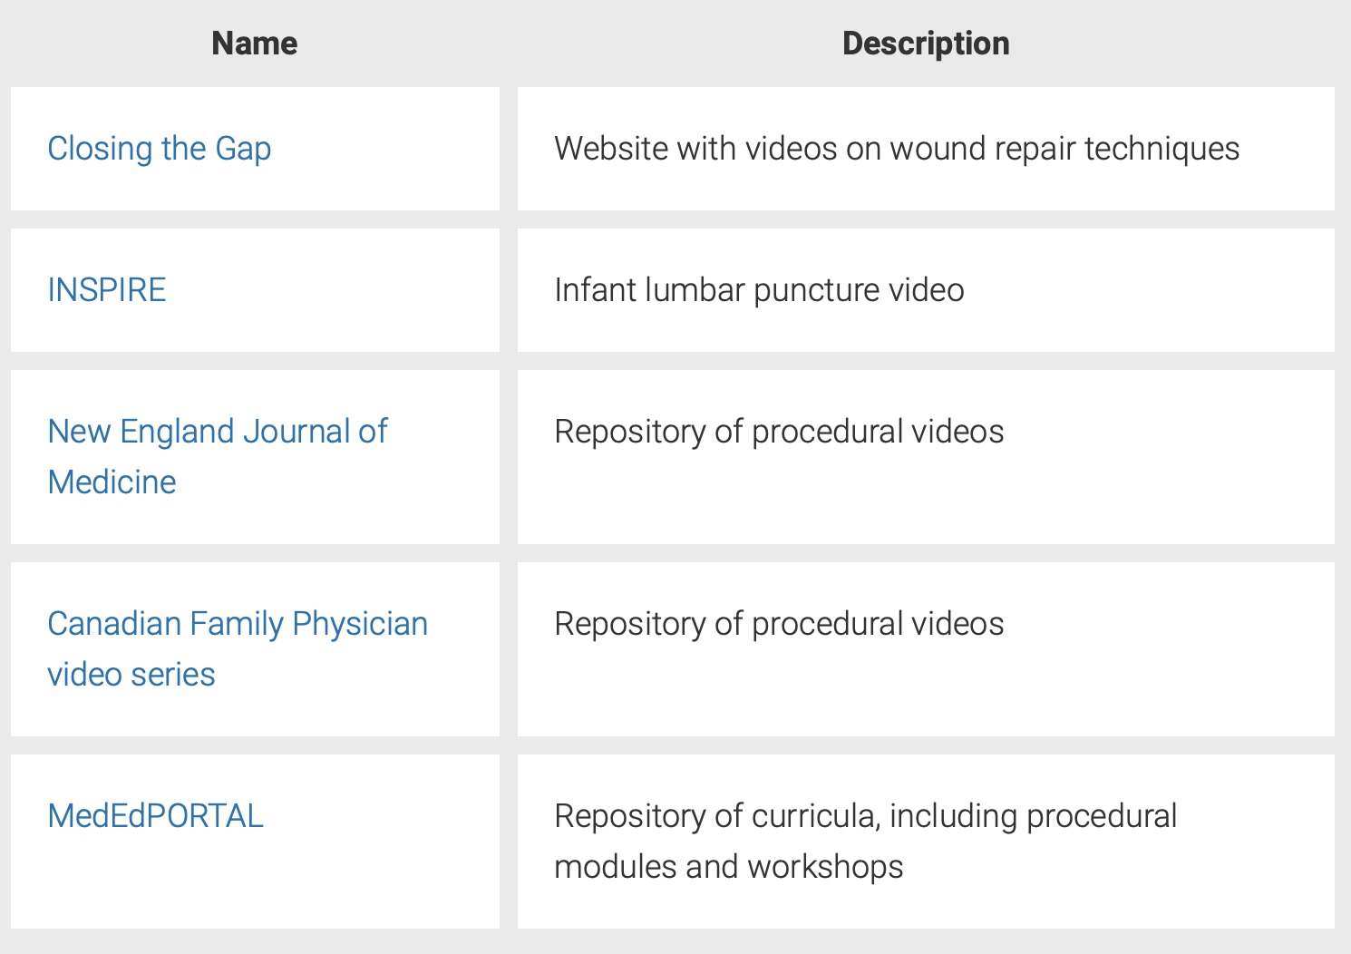
Videos
How to Teach Medical Procedures that Stick
Notes:
In other scenarios, a video will provide much better detail about a procedure, you can google anything and youtube has most procedures
Here are some resources
You will be able to access them on the Woo Insider

Slide 19
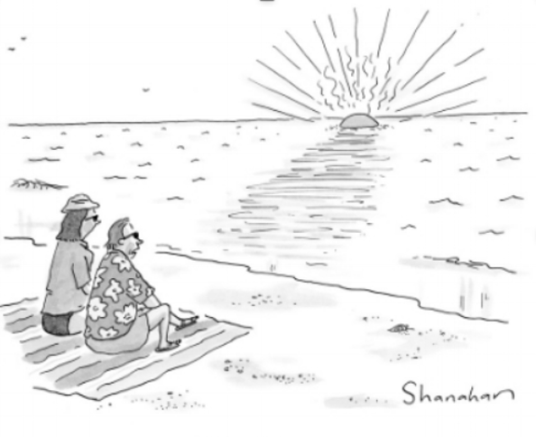
Introductory Phase
Participation – pre-knowledge
Provide a skills checklist
Consider visuals and/or videos
Commit steps to memory
“Commit this memory to memory”
Notes:
Just an unfortunate part of medicine, there are occasional times where you must commit steps to memory
And often times, when I’m doing some of these procedures, they become second nature
But initially, the learner should commit initial steps to memory especially those that are lengthy and require many steps
It helps with confidence prior to procedure for both learner and teacher
And most importantly, provides best outcomes for patients

Slide 20
2. Practice Phase

Slide 21
Practice Phase
Learner practicing the skill under direct observation
Consent obtained by learner
Answer patient’s questions while guiding learner
Active Summarization
Divide procedure if appropriate
Notes:
Practice phase where the learner may practice the skill under direct supervision or during simulation
If this is their first time, you can start by observing them obtain consent and describe the procedure
If they are at the level where they will be performing the procedure, it’s important to answer the patient’s question and explain to them that you’ll be supervising closely while guiding the learner
For safety and anticipation, it’s important the learner actively summarizes steps before proceeding
There are many different ways to supervise a procedure, based on complexity, learner experience and comfort level. You may have the learner observe and perform parts of the procedure. For example, during a complex wound repair, you can perform deep dermal sutures while the learner observes, and then have the learner perform simple sutures to close the wound. This is a great way for trainees to learn advanced techniques while practicing techniques they are already familiar with.

Slide 22
Feedback
Timely and specific
Moment to moment prompts
  Anticipate
  Flexibility
  Intervene if needed
Use reflection to reinforce the learning
  What landmarks do you palpate to find the correct LP site?
  How can you confirm that your wire is in the correct place?
End of procedure feedback
  Refer to skill checklist
  “Feedback Sandwich”
Notes:
Tenet of feedback here is timeliness and specific, you can’t get more timely and specific than moment to moment prompts
This allows learners to perform the procedure from start to finish while receiving immediate feedback on their technique.
However, be careful – avoid abrupt corrections as this can scare the patient and learner
Anticipate the next step
Flexibility – especially with deviations from the procedure if they’re not integral to the outcome
If the learner is struggling during a particular step, despite verbal feedback, the instructor may need to intervene to perform that step, and then hand the procedure back to the learner once it’s safe. For example, if the learner is struggling to insert the LP needle, the instructor can reposition the LP needle for successful insertion, then allow the learner to collect the cerebral spinal fluid and complete the procedure.
Reflection, a process in which you jog the learner’s memory with a question and NOT a correction
INSTEAD OF SAYING, "find the landmarks" or "please confirm the wire location"
End of procedure feedback
Refer to skill checklist to discuss specific steps
Use the feedback sandwich after the procedure – what went well, what was done wrong, and what can be improved next time

Slide 23
3. Perfecting Phase

Slide 24
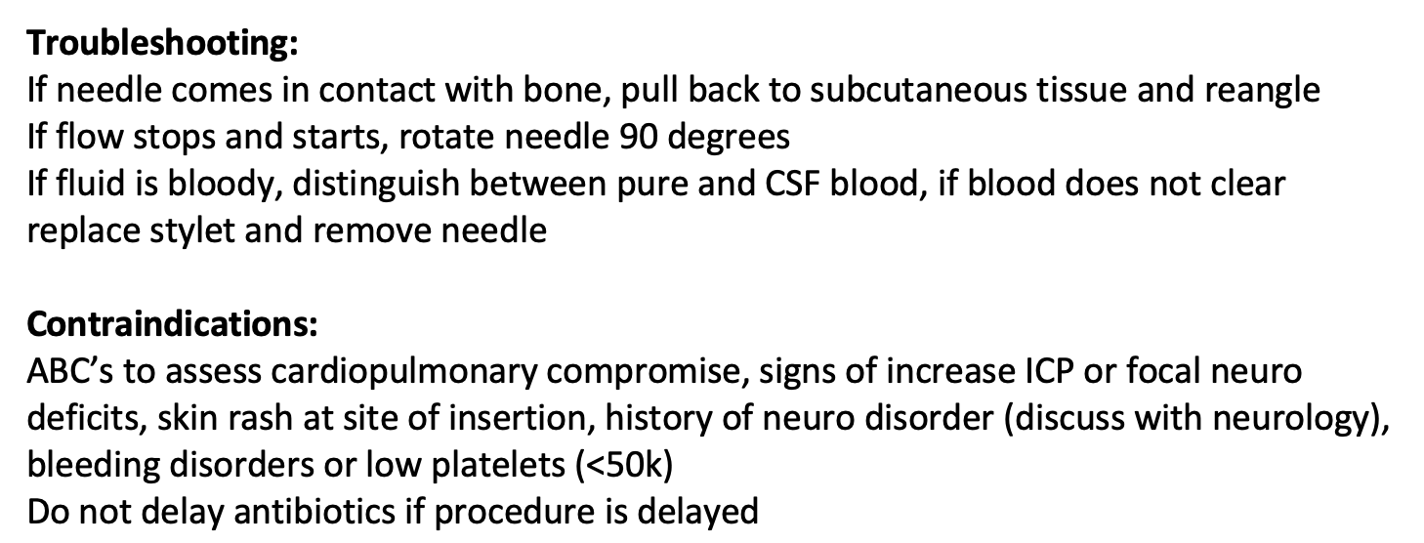
Perfecting Phase
Opportunity to practice the skill in multiple situations
Elaborate on finer points
Refer to skill checklist (below)
Notes:
It is important to provide feedback to the learner and answer questions.
Elaborate on finer points
Discuss specific instances with procedure where did not go to plan
If the procedure was successful, you could discuss possible pitfalls and ways to troubleshoot.
Skills checklist for trouble shooting and contraindications

Slide 25
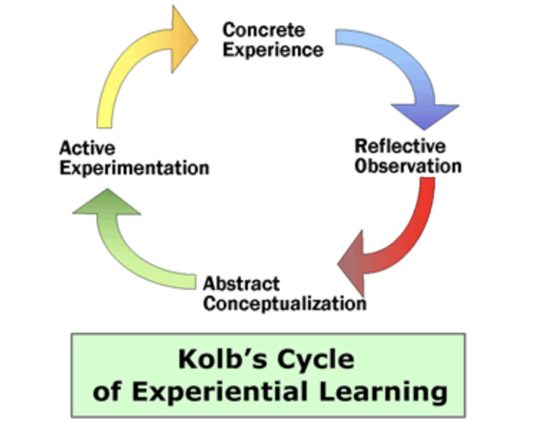
Notes:
Foster Kolb’s cycle of experiential learning
Concrete experience: any procedure or experience
Reflective observation: reflecting after or during procedure
Abstract conceptualization: constructing generalizations to reorganize knowledge into effective and efficient structures
Active Experimentation: testing the validity of insights (real or simulation)

Slide 26
Teaching Procedural Skills
Define the skill to be taught
Provide a concise overview (skill checklist)
Provide visuals and/or videos
Learner commit steps to memory
Demonstrate skill
Practice with feedback
Review past experiences with the skill
Elaborate on finer points
Discuss pitfalls or trouble shooting
Notes:
Provide increasingly difficult situations or elaborate finer points

Slide 27
Learning Objectives
Learners should be able to:
Identify the phases of procedural teaching
  - (introductory, practice, perfecting)
Adjust your approach to procedural teaching based on phase of learning
Create an objective list to outline a specific procedure (skills checklist)
Provide effective feedback during and post-procedurally
Define and foster experiential learning theory

Slide 28
Final Tips
Creating a skills checklist helps identify your own knowledge gaps
The best way to learn it is by doing it
Be sensitive to your learner
Try not to be overbearing while maintaining safety
Making a judgment-free zone allows learners to be more engaged
Do your best to provide feedback and areas of growth
Notes:
Skills checklist
Sensitive: recall the first time you performed a procedure, for me it was see one, see one, kind of try, do most of it, and then success. Personally, active experimentation provides for the best learning
At the same token, try not to be overbearing and allow the learner to fail and ask questions
Those questions can only be allowed in a judgement free zone
Feedback, we’re always looking for it from our attendings, make sure you’re also providing it

Slide 29
Questions?

Slide 30
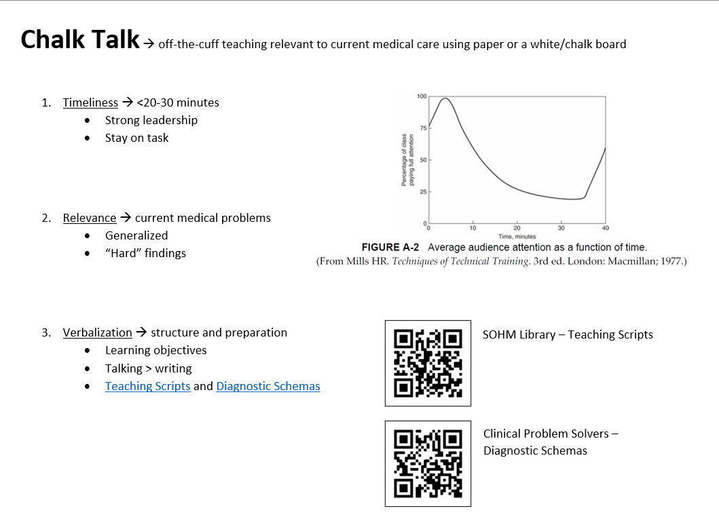

Slide 31
