Slide 1





Ice Breaker
What are some of the challenges that you face when teaching online?
……
……
……

Slide 2
Teaching in
VIRTUAL MODALITIES
reid evans, phd | reid.evans@umassmed.edu
……
……
……

Slide 3

My intent is to promote inclusive learning while avoiding bias.
I welcome feedback regarding areas for improvement.
……
……
……

Slide 4
QUESTION!
……
……
……
Notes:
You can respond in a few different ways…
In order for me to be more inclusive in my interactions with you, I would also ask you to identify yourself as you respond. This will allow me to be sure that I am addressing you in the manner that you’d like to be addressed.

Slide 5


Teaching in Virtual Modalities

Slide 6

OBJECTIVES
Learners will be able to:
Capitalize on the instructional affordances of tools such as PowerPoint and Zoom
Set expectations for and promote communication in virtual instruction
Apply principles of E-Learning Theory to curriculum development
Identify quality improvement goals related to virtual instruction

Slide 7

OVERVIEW
Layout, Logistics, and Design

Slide 8

OVERVIEW
Promoting
Communication

Slide 9

OVERVIEW
Principles of E-Learning Theory

Slide 10

OVERVIEW
A Checklist for Instruction

Slide 11
Ice Breaker
What are some of the challenges that you face when teaching online?
……
……
……

Slide 12

Layout Logistics
AND DESIGN
……
……
……

Slide 13
Layout, Logistics, and Design
Include learning objectives
Include an overview
Break learning into segments
Consider a roadmap
……
……
……

Slide 14
Layout, Logistics, and Design
QUESTION!
Capitalize on multimodality
……
……
……

Slide 15

Layout, Logistics, and Design
Learn the tools!
……
……
……

Slide 16

Layout, Logistics, and Design
Learn the tools!
……
……
……

Slide 17
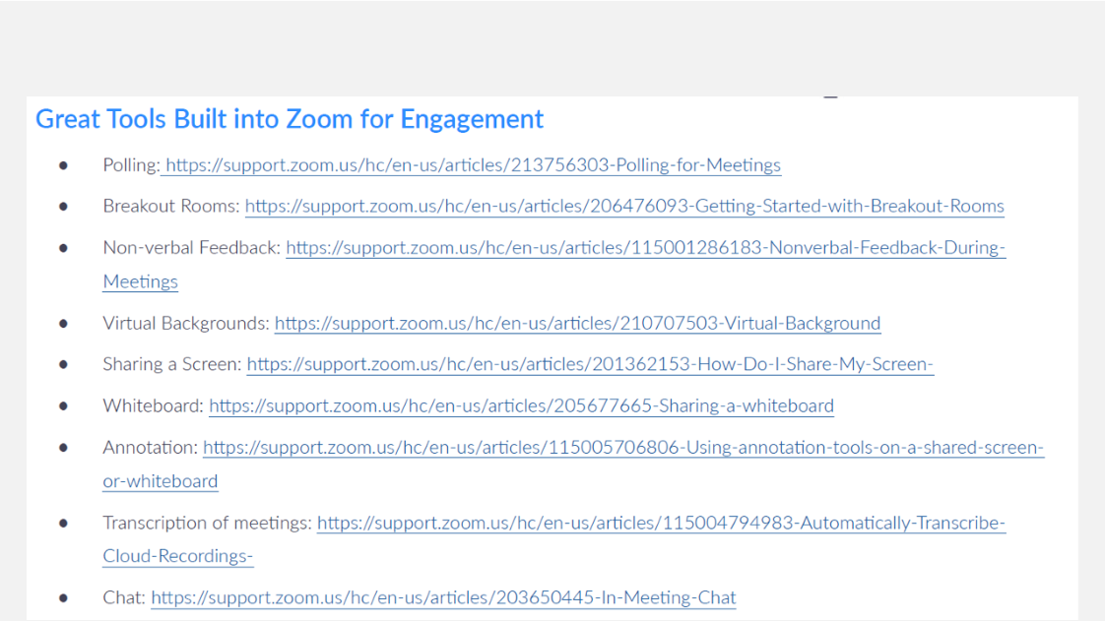
Layout, Logistics, and Design
Learn the tools!
……
……
……

Slide 18
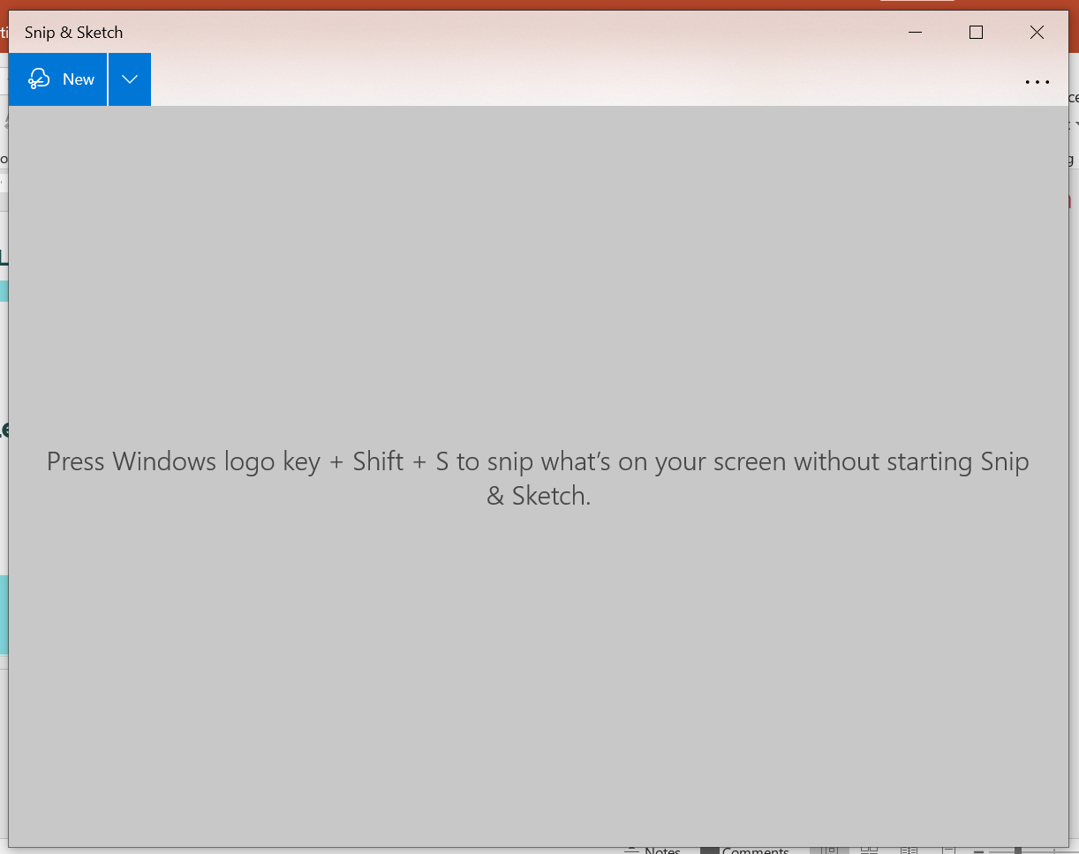
Embed videos and images in PPT to save time

Slide 19
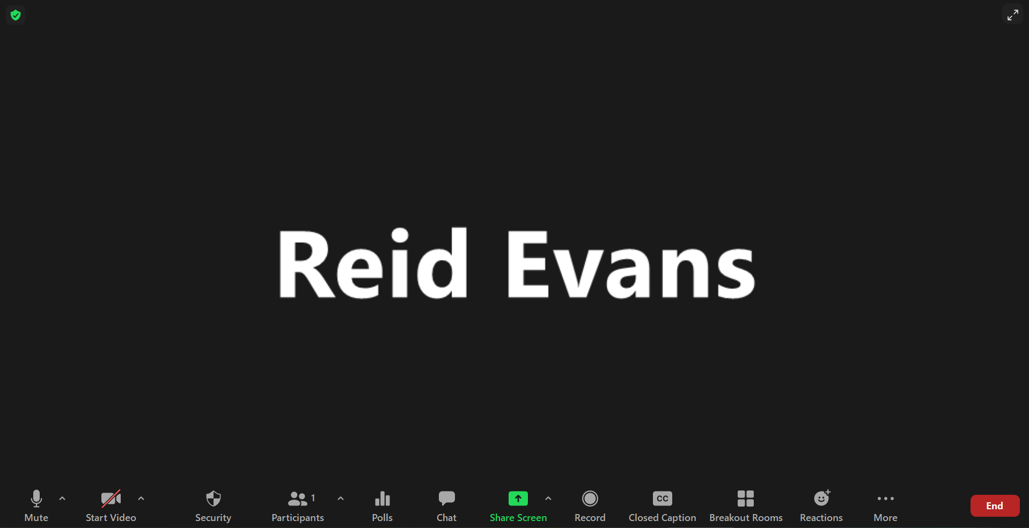
Use Screen Share to Your Advantage

Slide 20
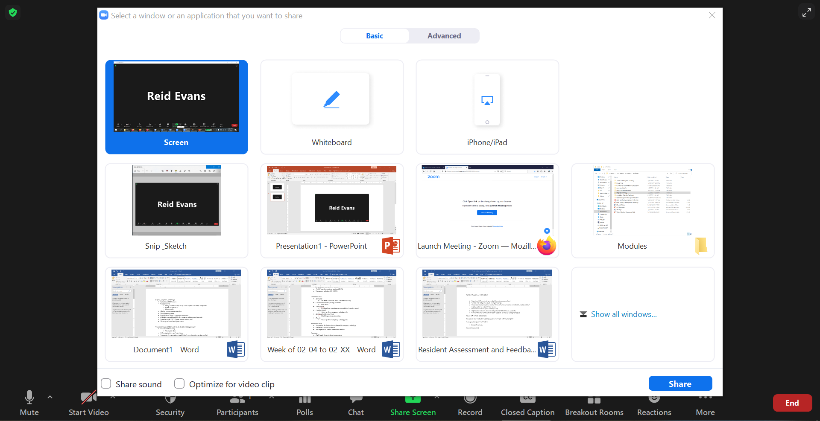

Slide 21
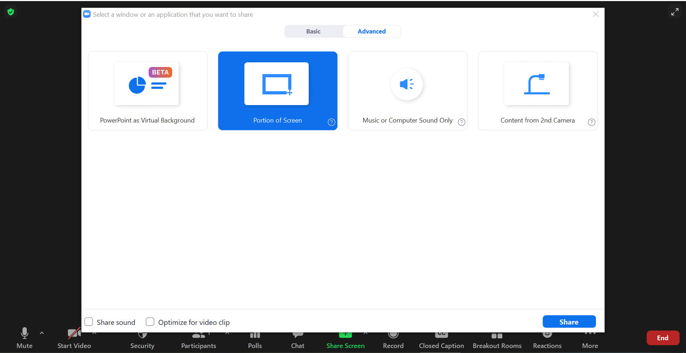

Slide 22
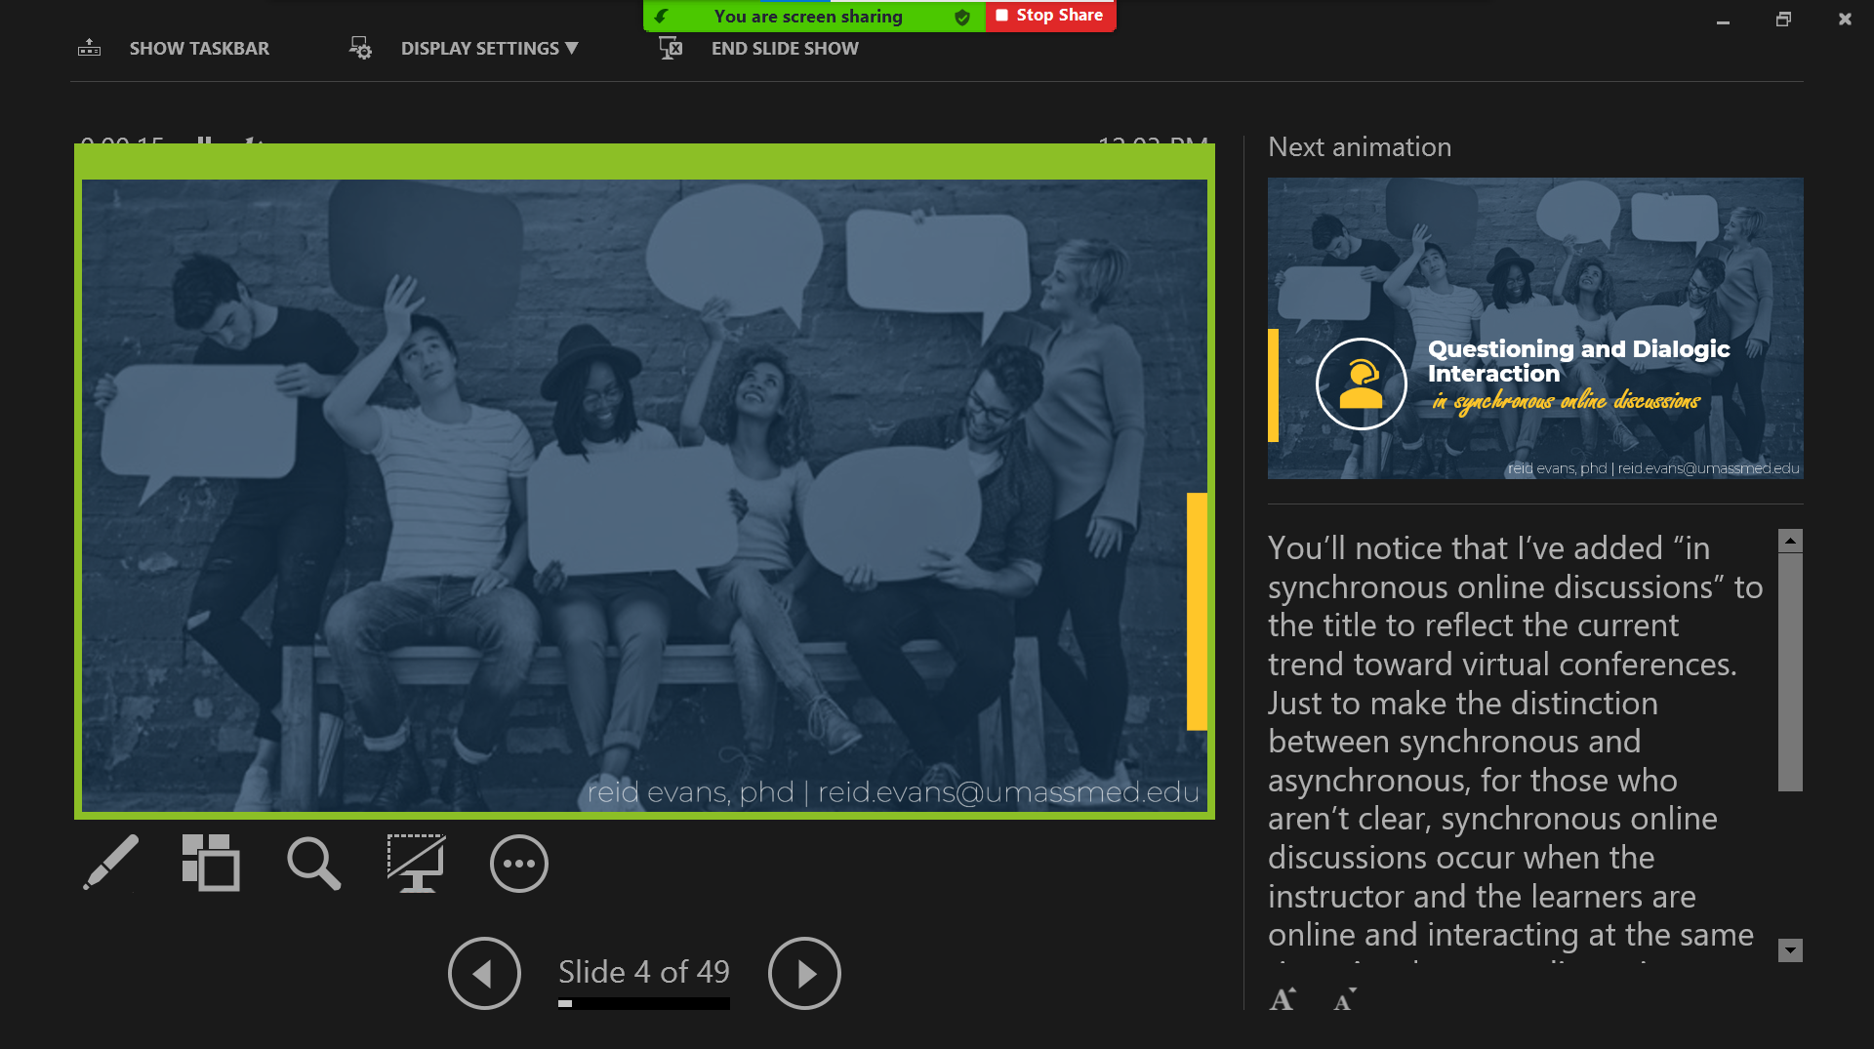

Slide 23
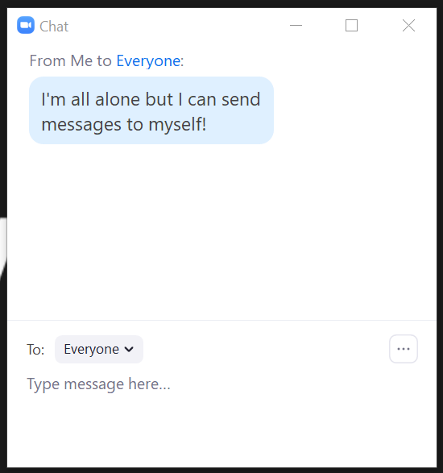
Layout, Logistics, and Design
Capitalize on Zoom’s Communication Tools
……
……
……

Slide 24
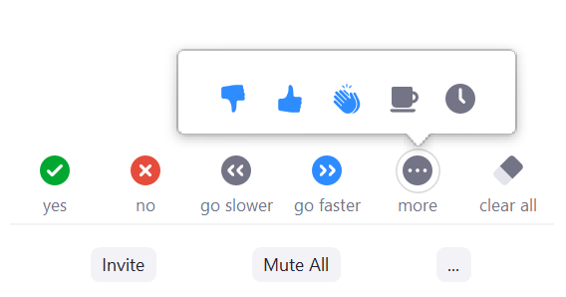
Layout, Logistics, and Design
Capitalize on Zoom’s Communication Tools
……
……
……

Slide 25
Layout, Logistics, and Design
Capitalize on Zoom’s Communication Tools
……
……
……

Slide 26
Layout, Logistics, and Design
Keep it simple
Limit words per slide
Show up early
Anticipate issues
……
……
……

Slide 27

Promoting
COMMUNICATION
……
……
……

Slide 28

Promoting Communication
Virtual instruction can be isolating
……
……
……

Slide 29
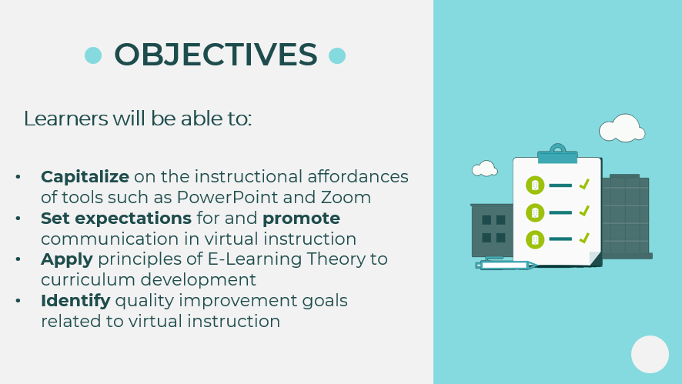
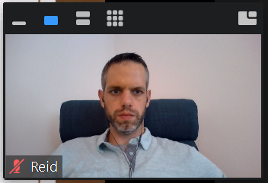
Promoting Communication
Create “teacher presence”
(Garrison et al., 1999)
reid.evans@umassmed.edu
Office hours:
Tues. 8-9 am, Thurs. 4-5 pm
……
……
……

Slide 30
Promoting Communication
Define expectations for participation
Discuss logistics of participation
Include opportunities for interaction
……
……
……

Slide 31
Promoting Communication
“Please come prepared to discuss active learning strategies”
“Please come prepared with a pen and paper”
Ask participants to prepare
……
……
……

Slide 32
Promoting Communication
Seek feedback
Incorporate that feedback into future iterations of instruction
……
……
……

Slide 33

Principles of
E-Learning Theory
……
……
……

Slide 34
E-Learning Theory
Have you ever considered the theories that inform your instruction?
……
……
……

Slide 35


E-Learning Theory
Multimedia Principle
Using any two out of the combination of audio, visuals, and text promotes deeper learning than using just one or all three
……
……
……

Slide 36
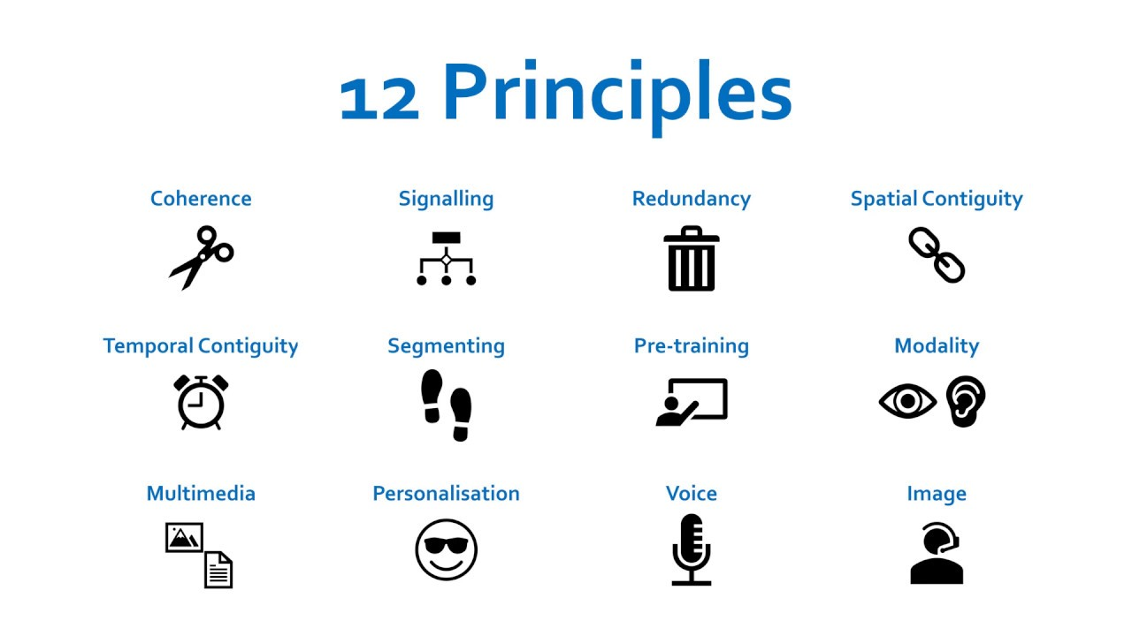
E-Learning Theory
Multimedia Principle
Using any two out of the combination of audio, visuals, and text promote deeper learning than using just one or all three
……
……
……

Slide 37
E-Learning Theory
Modality Principle
Learning is more effective when visuals are accompanied by audio narration versus onscreen text
……
……
……

Slide 38
E-Learning Theory
……
……
……

Slide 39
E-Learning Theory
Coherence Principle
The less that learners know about the presentation content, the more they will be distracted by unrelated content
……
……
……

Slide 40
E-Learning Theory
Segmenting Principle
More effective learning happens when learning is segmented into smaller chunks
……
……
……

Slide 41
E-Learning Theory
Signaling Principle
Using arrows or circles, highlighting, and pausing in speech are all effective methods of signaling important aspects of the lesson
……
……
……

Slide 42

A Checklist
FOR INSTRUCTION
……
……
……

Slide 43
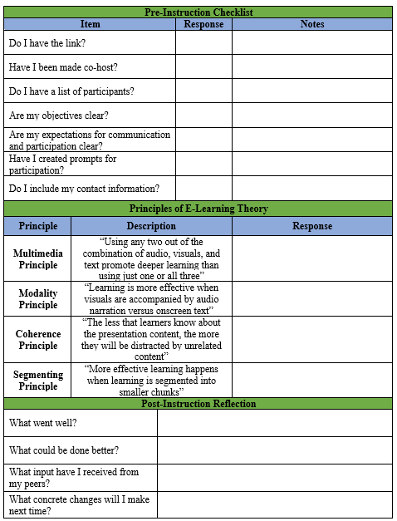
……
……
……

Slide 44
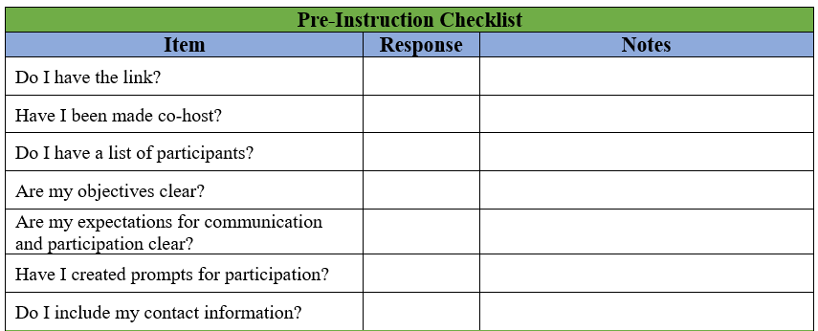
……
……
……

Slide 45
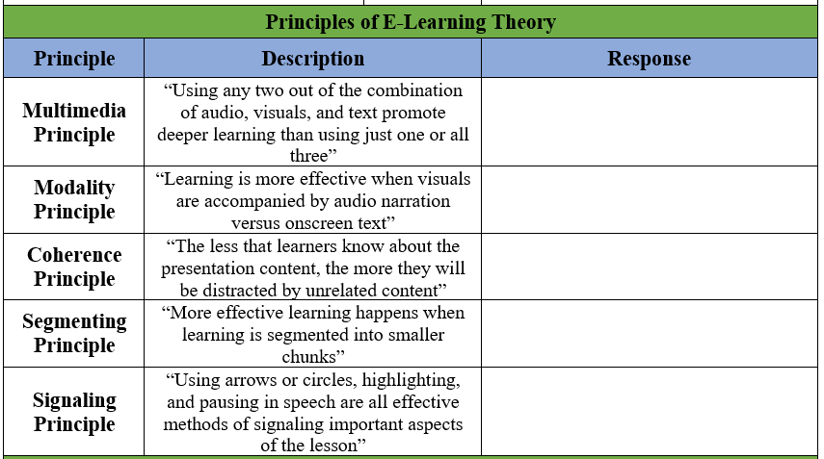
……
……
……

Slide 46
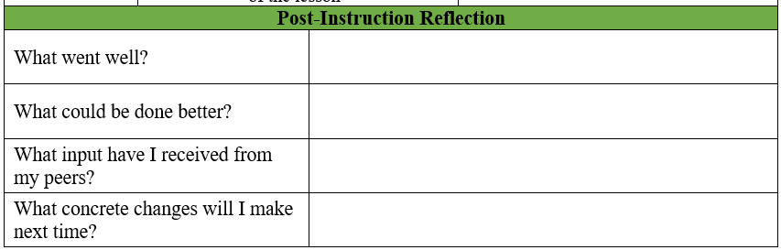
……
……
……

Slide 47
What are one or two concrete changes that we can make to our virtual instruction?
……
……
……

Slide 48
Thank you!
reid.evans@umassmed.edu
……
……
……

Slide 49
