Slide 1


Your practice logo here
Mental Health Care Workflow Training
Practice Name
Date

Slide 2
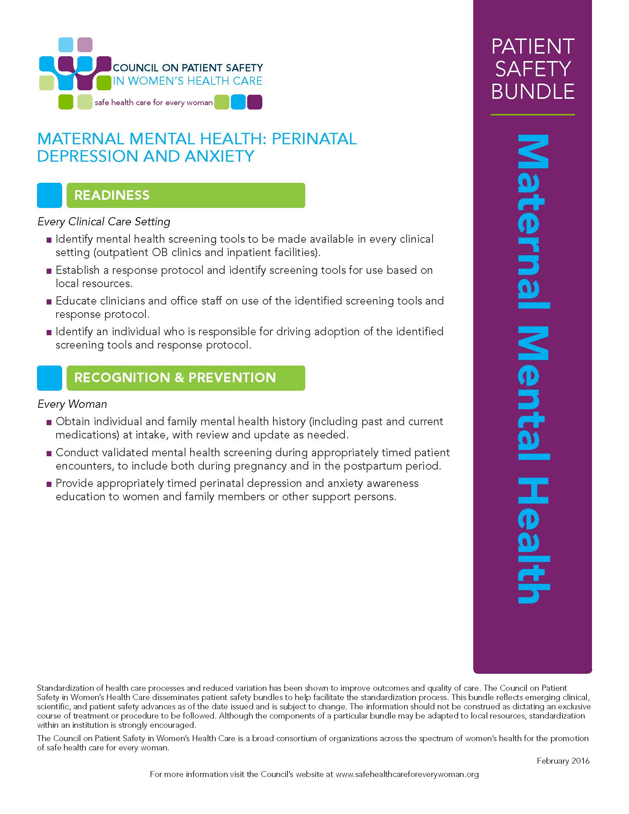
We are committed to meeting the new standard of care by including mental health care as part of obstetric care
  Obstetric care includes addressing mental health
  By addressing mental health, we can all help eliminate preventable maternal morbidity and mortality

Slide 3
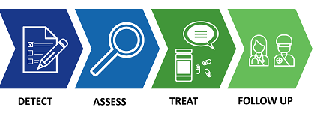
We are implementing the maternal mental health patient safety bundle using a Quality Improvement approach
We are using a structured protocol that aims to integrate mental health care as part of obstetric care.
As part of this initiative, we’ve formed a QI team to assess and adjust our workflow to systematically address mental health. We will look at all aspects of the depression care pathway:
The team that has been working on this includes:
  [QI Implementation Team member names here]

Slide 4
Now let’s go through the general Aims that will help us integrate the full mental health care pathway into our care…detect, assess, treat, and follow up

Slide 5
General aims for supporting metal health care through the continuum
Aim 1. Provide psychoeducation, destigmatize perinatal mental health conditions, and help engage perinatal individuals using a strength-based and culturally-responsive approach.

Slide 6
General aims for supporting metal health care through the continuum
Aim 1. Provide psychoeducation, destigmatize perinatal mental health conditions, and help engage perinatal individuals using a strength-based and culturally-responsive approach.
Aim 2. Implement screening for depression and anxiety twice during pregnancy (at initiation and at 24-28 weeks gestation) and at least once in the postpartum period (6 weeks postpartum).

Slide 7
General aims for supporting metal health care through the continuum
Aim 1. Provide psychoeducation, destigmatize perinatal mental health conditions, and help engage perinatal individuals using a strength-based and culturally-responsive approach.
Aim 2. Implement screening for depression and anxiety twice during pregnancy (at initiation and at 24-28 weeks gestation) and at least once in the postpartum period (6 weeks postpartum).
Aim 3. Implement screening for bipolar disorder at initiation of care or after a positive depression screen.

Slide 8
General aims for supporting metal health care through the continuum
Aim 1. Provide psychoeducation, destigmatize perinatal mental health conditions, and help engage perinatal individuals using a strength-based and culturally-responsive approach.
Aim 2. Implement screening for depression and anxiety twice during pregnancy (at initiation and at 24-28 weeks gestation) and at least once in the postpartum period (6 weeks postpartum).
Aim 3. Implement screening for bipolar disorder at initiation of care or after a positive depression screen.
Aim 4. When a perinatal mental health screening tool is positive, assess the patient and determine treatment approach.

Slide 9
General aims for supporting metal health care through the continuum
Aim 1. Provide psychoeducation, destigmatize perinatal mental health conditions, and help engage perinatal individuals using a strength-based and culturally-responsive approach.
Aim 2. Implement screening for depression and anxiety twice during pregnancy (at initiation and at 24-28 weeks gestation) and at least once in the postpartum period (6 weeks postpartum).
Aim 3. Implement screening for bipolar disorder at initiation of care or after a positive depression screen.
Aim 4. When a perinatal mental health screening tool is positive, assess the patient and determine treatment approach.
Aim 5. Develop and use a repository of mental health resources and treatment referral sources tailored to the needs of your patient population.

Slide 10
General aims for supporting metal health care through the continuum
Aim 1. Provide psychoeducation, destigmatize perinatal mental health conditions, and help engage perinatal individuals using a strength-based and culturally-responsive approach.
Aim 2. Implement screening for depression and anxiety twice during pregnancy (at initiation and at 24-28 weeks gestation) and at least once in the postpartum period (6 weeks postpartum).
Aim 3. Implement screening for bipolar disorder at initiation of care or after a positive depression screen.
Aim 4. When a perinatal mental health screening tool is positive, assess the patient and determine treatment approach.
Aim 5. Develop and use a repository of mental health resources and treatment referral sources tailored to the needs of your patient population.
Aim 6. Refer patients who screen positive for psychotherapy, group therapy, or other treatment and support options.

Slide 11
General aims for supporting metal health care through the continuum
Aim 1. Provide psychoeducation, destigmatize perinatal mental health conditions, and help engage perinatal individuals using a strength-based and culturally-responsive approach.
Aim 2. Implement screening for depression and anxiety twice during pregnancy (at initiation and at 24-28 weeks gestation) and at least once in the postpartum period (6 weeks postpartum).
Aim 3. Implement screening for bipolar disorder at initiation of care or after a positive depression screen.
Aim 4. When a perinatal mental health screening tool is positive, assess the patient and determine treatment approach.
Aim 5. Develop and use a repository of mental health resources and treatment referral sources tailored to the needs of your patient population.
Aim 6. Refer patients who screen positive for psychotherapy, group therapy, or other treatment and support options.
Aim 7. Start medication treatment when indicated.

Slide 12
General aims for supporting metal health care through the continuum
Aim 1. Provide psychoeducation, destigmatize perinatal mental health conditions, and help engage perinatal individuals using a strength-based and culturally-responsive approach.
Aim 2. Implement screening for depression and anxiety twice during pregnancy (at initiation and at 24-28 weeks gestation) and at least once in the postpartum period (6 weeks postpartum).
Aim 3. Implement screening for bipolar disorder at initiation of care or after a positive depression screen.
Aim 4. When a perinatal mental health screening tool is positive, assess the patient and determine treatment approach.
Aim 5. Develop and use a repository of mental health resources and treatment referral sources tailored to the needs of your patient population.
Aim 6. Refer patients who screen positive for psychotherapy, group therapy, or other treatment and support options.
Aim 7. Start medication treatment when indicated.
Aim 8. Follow-up and monitor perinatal mental health conditions once treatment is initiated.

Slide 13
General aims for supporting metal health care through the continuum
Aim 1. Provide psychoeducation, destigmatize perinatal mental health conditions, and help engage perinatal individuals using a strength-based and culturally-responsive approach.
Aim 2. Implement screening for depression and anxiety twice during pregnancy (at initiation and at 24-28 weeks gestation) and at least once in the postpartum period (6 weeks postpartum).
Aim 3. Implement screening for bipolar disorder at initiation of care or after a positive depression screen.
Aim 4. When a perinatal mental health screening tool is positive, assess the patient and determine treatment approach.
Aim 5. Develop and use a repository of mental health resources and treatment referral sources tailored to the needs of your patient population.
Aim 6. Refer patients who screen positive for psychotherapy, group therapy, or other treatment and support options.
Aim 7. Start medication treatment when indicated.
Aim 8. Follow-up and monitor perinatal mental health conditions once treatment is initiated.
Aim 9. Ensure mental health care is ongoing until at least one year postpartum with transition to primary care or another provider as needed.

Slide 14
What our practice is doing now
(Results of baseline assessment)
Aim 1. Provide psychoeducation, destigmatize perinatal mental health conditions, and help engage perinatal individuals using a strength-based and culturally-responsive approach.
[List practice activities related to this aim that are currently in place, for example mental health educational materials routinely provided, posters or brochures hung or displayed in patient areas]
[See Tool to Schedule Implementation and Create Practice Goals, Crosswalk Output tab, Aim 1 results beginning on row 5)

Slide 15

What our practice is doing now
(Results of baseline assessment)
Aim 2. Implement screening for depression and anxiety twice during pregnancy (at initiation and at 24-28 weeks gestation) and at least once in the postpartum period (6 weeks postpartum).
Aim 3. Implement screening for bipolar disorder at initiation of care or after a positive depression screen.
Screening for | First half of pregnancy | Second half of pregnancy | Postpartum
Depression | [row 29] | [row 30] | [row 31]
Bipolar Disorder | [row 50]
Anxiety | [row 33] | [row 34] | [row 35]
PTSD | [row 37] | [row 38] | [row 39]
[Update the above table with your practice information from the Tool to Schedule Implementation and Create Practice Goals, Crosswalk Output Tab. The rows that contain the results are indicated in red in the above table. Add a checkmark to the cell where your results are 80% or above.

Slide 16
What our practice is doing now
(Results of baseline assessment)
Aim 4. When a perinatal mental health screening tool is positive, assess the patient and determine treatment approach.
[Add text here from the Tool to Schedule Implementation and Create Practice Goals, Crosswalk Output tab, Aim 4 results beginning on row 54]

Slide 17
What our practice is doing now
(Results of baseline assessment)
Aim 5. Develop and use a repository of mental health resources and treatment referral sources tailored to the needs of your patient population.
.
[Do you have a repository of mental health resource and treatment referral sources. If yes, provide detail about where it is and how to access it. Add results from the Tool to Schedule Implementation and Create Practice Goals, Crosswalk Output tab, Aim 5 results beginning on row 67]

Slide 18
What our practice is doing now
(Results of baseline assessment)
Aim 6. Refer patients who screen positive for psychotherapy, group therapy, or other treatment and support options.
[Add to this slide any results from the Tool to Schedule Implementation and Create Practice Goals Crosswalk Output tab, Aim 6 results beginning on row 76]

Slide 19
What our practice is doing now
(Results of baseline assessment)
Aim 7. Start medication treatment when indicated.
[Add to this slide any results from the Tool to Schedule Implementation and Create Practice Goals, Crosswalk Output tab, Aim 7 results beginning on row 87]

Slide 20
What our practice is doing now
(Results of baseline assessment)
Aim 8. Follow-up and monitor perinatal mental health conditions once treatment is initiated.
[Add to this slide any results from the Tool to Schedule Implementation and Create Practice Goals, Crosswalk Output tab, Aim 8 rows beginning on row 98]

Slide 21
What our practice is doing now
(Results of baseline assessment)
Aim 9. Ensure mental health care is ongoing until at least one year postpartum with transition to primary care or another provider as needed.
[Add to this slide any results from the Tool to Schedule Implementation and Create Practice Goals, Crosswalk Output tab, Aim 9 results beginning on row 109]

Slide 22
Now we will talk about how we are going to close the gap

Slide 23
Aim 1:
[write your goal(s) related to psychoeducation/ reducing stigma here]
[List activities planned to address this goal/these goals]

Slide 24
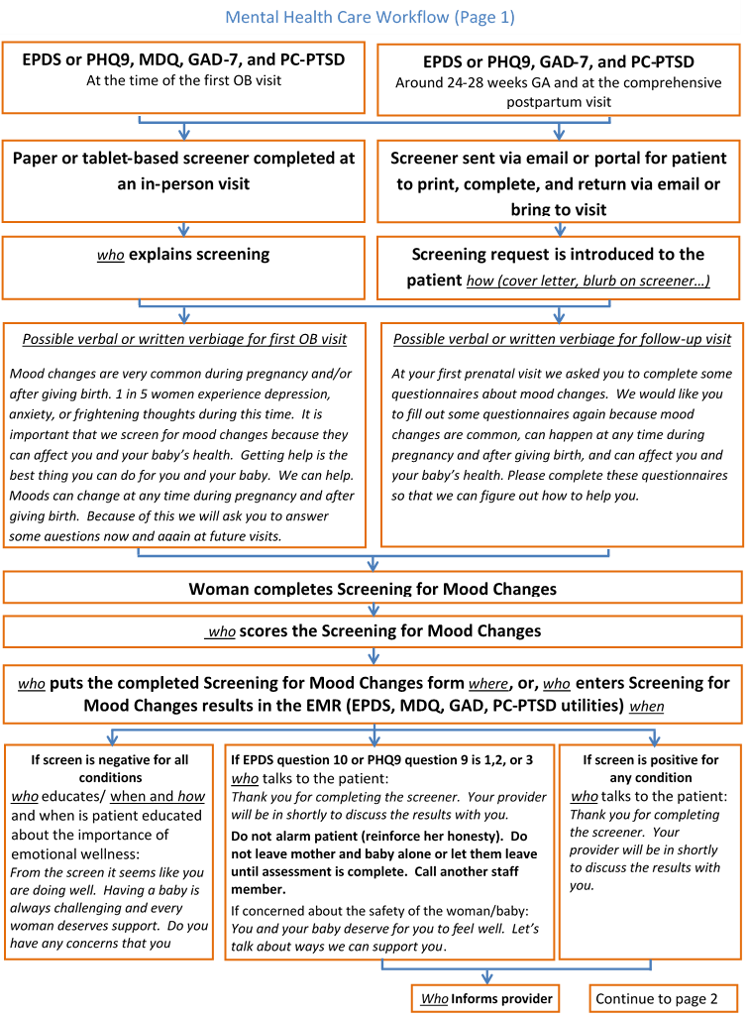
EXAMPLE Slide – remove this slide after completing the following slide
Aims 2 and 3:
[write your goal(s) related to screening here]
We’ve put together a new workflow for the changes related to mental health care. We have provided you with a copy. Page 1 describes screening procedures
Example

Slide 25
Aims 2 and 3:
[write your goal(s) related to screening here]
We’ve put together a new workflow for the changes related to mental health care. We have provided you with a copy. Page 1 describes screening procedures
For patients who screen negative, we would like to let them know the results of the screening. We’ve included some verbiage on the bottom of Workflow page 1.
[Insert page 1 of your practice workflow here]

Slide 26
Aims 2 and 3:
[write your goal(s) related to screening here]
Screening for depression, bipolar disorder, anxiety, posttraumatic stress disorder using the EPDS/PHQ-9, MDQ, GAD-7, and PCL-PTSD at intake.
[Write how the screener will get completed – paper or electronic? How, when, and where will the patient be asked to complete it at this time point?]

Slide 27
Aims 2 and 3:
[write your goal(s) related to screening here]
Screening for depression, anxiety, posttraumatic stress disorder using the EPDS/PHQ-9, GAD-7, and PCL-PTSD at 24-28 weeks GA and X weeks postpartum.
[Write how the screener will get completed – paper or electronic? How, when, and where will the patient be asked to complete it at these time points?]

Slide 28
Aims 2 and 3:
write your goal(s) related to screening here
The new screener has a scoring companion to help you learn to score the screener. You have copies of both the screeners we will use at initial and follow up time points, and their scoring companions.
[Write what happens to the completed screeners at each time point. Who scores it? If not the provider, how are results communicated to the provider? What happens to the completed form if it is a paper form. Does it get scanned? Are the values or results entered into the EMR and the form is shredded? Who takes care of the completed form?]
A Depression (EPDS) | Please circle one of the four answers that comes closest to how you have felt in the past 7 days, not just how you feel today.
I have been able to laugh and see the funny side of things* |  | 0As much as I always | 1Not quite so | 2Definitely not so | 3Not at all | ____Grand total
I have looked forward with enjoyment to things* |  | 0As much as I ever .. | 1Rather less | 2Definitely less .. | 3Hardly at all
I have blamed myself unnecessarily when things when wrong |  | 3Yes, most of the … | 2Yes, some of | 1Not very often | 0No never
I have been anxious or worried for no good reason* |  | 0No, not at all | 1Hardly ever | 2Yes, sometimes | 3Yes, very …
I have felt scared or panicky for no good reason |  | 3Yes, quite a lot | 2Yes, … | 1No, not much | 0No, not at all

Slide 29
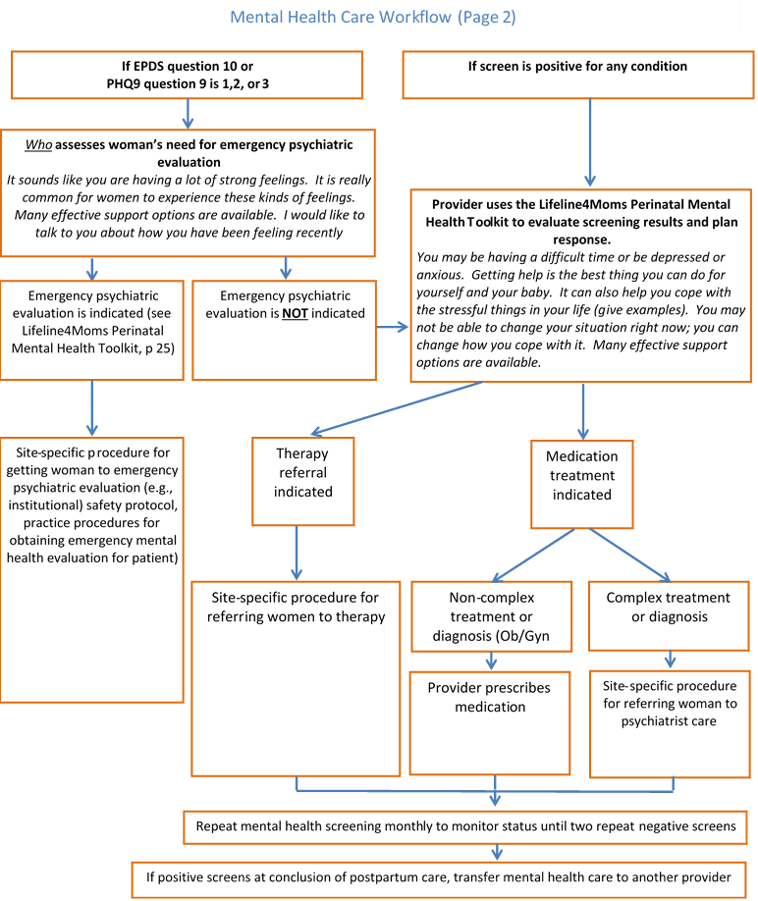
[EXAMPLE Slide – remove this slide after completing the following slide]
Aim 4:
[write your goal(s) related to assessment and treatment here]
We’ve put together a new workflow for the changes related to mental health care. We have provided you with a copy. Workflow page 2 describes what happens after screening
Example

Slide 30
Aim 4:
[write your goal(s) related to assessment and treatment here]
We’ve put together a new workflow for the changes related to mental health care. We have provided you with a copy. Page 2 describes what happens after screening
[Insert page 2 of your practice workflow here (can be copied and pasted as an image)]

Slide 31
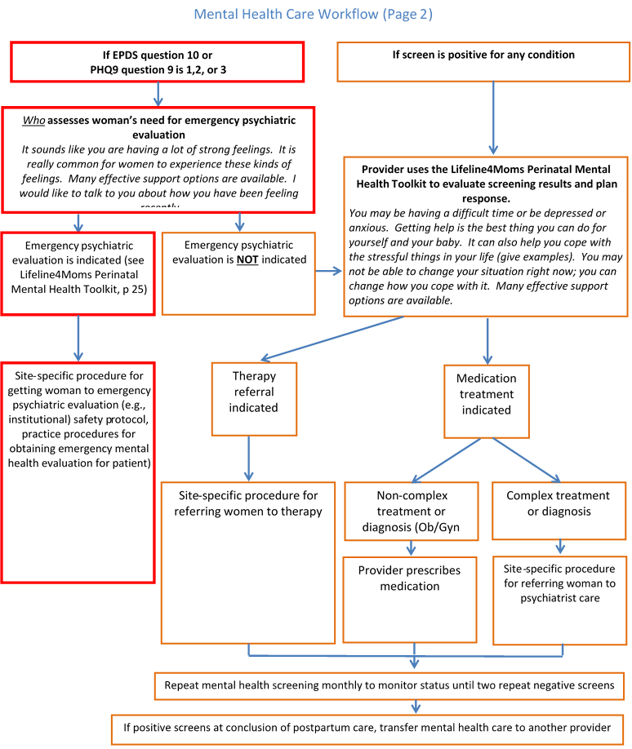
Aim 4:
[write your goal(s) related to assessment and treatment as related to emergency mental health here]
We’ve put together a new workflow for the changes related to mental health care. We have provided you with a copy. Page 2 describes what happens after screening. This section addresses what happens if the patient indicates they have had thoughts of harming themselves.

Slide 32
[EXAMPLE Slide – remove this slide after completing the following slide]
If EPDS question 10 or
PHQ9 question 9 is 1,2, or 3
Aim 4:
[write your goal(s) related to assessment and treatment as related to emergency mental health]
We’ve put together a new workflow for the changes related to mental health care. We have provided you with a copy. Page 2 describes what happens after screening
If the screening results suggest a need for an emergency mental health evaluation (1,2, or 3 on the EPDS). This will be our workflow.
Who assesses individual’s need for emergency psychiatric evaluation
It sounds like you are having a lot of strong feelings. It is really common for perinatal individuals to experience these kinds of feelings. Many effective support options are available. I would like to talk to you about how you have been feeling recently
Example
Emergency psychiatric evaluation is indicated (see Lifeline4Moms Perinatal Mental Health Toolkit, p 25)
Remove this slide after completing the following slide
Site-specific procedure for getting individual to emergency psychiatric evaluation (e.g., institutional) safety protocol, practice procedures for obtaining emergency mental health evaluation for patient)

Slide 33
Aim 4:
[write your goal(s) related to assessment and treatment as related to emergency mental health]
We’ve put together a new workflow for the changes related to mental health care. We have provided you with a copy. Page 2 describes what happens after screening
If the screening results suggest a need for an emergency mental health evaluation (1,2, or 3 on the EPDS). This will be our workflow.
If EPDS question 10 or
PHQ9 question 9 is 1,2, or 3
Who assesses individual’s need for emergency psychiatric evaluation
It sounds like you are having a lot of strong feelings. It is really common for perinatal individuals to experience these kinds of feelings. Many effective support options are available. I would like to talk to you about how you have been feeling recently
Emergency psychiatric evaluation is indicated (see Lifeline4Moms Perinatal Mental Health Toolkit, p 25)
Site-specific procedure for getting the indivdual to emergency psychiatric evaluation (e.g., institutional) safety protocol, practice procedures for obtaining emergency mental health evaluation for patient)

Slide 34
Aim 4:
[write your goal(s) related to assessment of patients who screen positive for a mental health condition here]
We’ve put together a workflow for the changes related to mental health care. We have provided you with a copy. Page 2 describes what happens after screening for patients who screen positive.

Slide 35
[EXAMPLE Slide – remove this slide after completing the following slide]
If screen is positive for any condition
Aim 4:
[Write your goal(s) related to assessment and treatment of patients who screen positive for a mental health condition here]
We’ve put together a new workflow for the changes related to mental health care. We have provided you with a copy. Page 2 describes what happens after screening.
If the screening result is positive. This will be our workflow
Example
Provider uses the Lifeline4Moms Perinatal Mental Health Toolkit to evaluate screening results and plan response.
You may be having a difficult time or be depressed or anxious. Getting help is the best thing you can do for yourself and your baby. It can also help you cope with the stressful things in your life (give examples). You may not be able to change your situation right now; you can change how you cope with it. Many effective support options are available.
Therapy referral indicated
Medication treatment indicated

Slide 36
Aim 4:
[Write your goal(s) related to assessment of patients who screen positive for a mental health condition here]
We’ve put together a new workflow for the changes related to mental health care. We have provided you with a copy. Page 2 describes what happens after screening.
If the screening result is positive. This will be our workflow
If screen is positive for any condition
Provider uses the Lifeline4Moms Perinatal Mental Health Toolkit to evaluate screening results and plan response.
You may be having a difficult time or be depressed or anxious. Getting help is the best thing you can do for yourself and your baby. It can also help you cope with the stressful things in your life (give examples). You may not be able to change your situation right now; you can change how you cope with it. Many effective support options are available.
Therapy referral indicated
Medication treatment indicated

Slide 37
Aim 5:
[Write your goal(s) related to developing a repository]
We’ve begun developing a repository of resources for perinatal mental health conditions including available patient and practice educational materials, resources for providers and staff to learn about perinatal mental health, and referral sites. It can be found [where]

Slide 38
Aim 6:
[Write your goal(s) related to write your goal(s) related to referral to therapy here]
We’ve put together a new workflow for the changes related to mental health care. We have provided you with a copy. Page 2 describes what happens after screening when an individual screens positive and it is determined their treatment will include therapy.

Slide 39
Aim 6:
[Write your goal(s) related to referral to therapy]
We’ve put together a new workflow for the changes related to mental health care. We have provided you with a copy. Page 2 describes what happens after screening
If therapy is indicated, this will be our workflow
Therapy referral indicated
Site-specific procedure for referring patients to therapy
[Add your site-specific workflow here]

Slide 40
Aim 7:
[Write your goal(s) related to treatment with medication here]
We’ve put together a new workflow for the changes related to mental health care. We have provided you with a copy. Page 2 describes what happens after screening

Slide 41
Aim 7:
[Write your goal(s) related to medication treatment]
We’ve put together a new workflow for the changes related to mental health care. We have provided you with a copy. Page 2 describes what happens after screening
If medication is indicated, this will be our workflow
Medication treatment indicated
Non-complex treatment or diagnosis (Ob/Gyn comfortable treating)
Complex treatment or diagnosis
Provider prescribes medication
Site-specific procedure for referring individual to psychiatrist care
[Add your site-specific workflow here]

Slide 42
Aim 8:
[Write your goal(s) related to follow-up and monitoring here]
We’ve put together a new workflow for the changes related to mental health care. We have provided you with a copy. Page 2 describes what happens after screening once treatment is initiated.

Slide 43
Aim 8:
[Write your goal(s) related to follow-up and monitoring]
We’ve put together a new workflow for the changes related to mental health care. We have provided you with a copy. Page 2 describes what happens after screening once treatment is initiated
For all patients identified as screening positive for a mental health condition we will follow up and monitor by [add your procedure here]
Repeat mental health screening monthly to monitor status until two repeat negative screens

Slide 44
Aim 9:
[Write your goal(s) related to transitioning care if mental health condition is unresolved]
We’ve put together a new workflow for the changes related to mental health care. We have provided you with a copy. Page 2 describes what happens if happens if the patient screens positive at the postpartum visit screening

Slide 45
Aim 9:
[Write your goal(s) related to transitioning care if mental health condition is unresolved]
We’ve put together a new workflow for the changes related to mental health care. We have provided you with a copy. Page 2 describes what happens if the patient screens positive at the postpartum visit screening
If the patient screening remains positive at the time of the last visit, this this will be our workflow for transitioning care: [write your practice-specific procedure]
If positive screens at conclusion of postpartum care, transfer mental health care to another provider

Slide 46

QUESTIONS?

Slide 47


Integrating mental health care into our practice can be transformative for the perinatal individuals we serve

Slide 48


We appreciate everyone’s commitment to this initiative

