Slide 1
Everything You Wanted to Know about the IRB and Then Some
Human Subjects Research (HSR),
IRBs and UMass Chan IRB Essentials
Spring 2023 | Heather M. Strom Tessier, MA – IRB Educational Specialist

Slide 2
Before We Begin…
Introduction to Mentimeter Interactive Presentation Tool

Slide 3
Ice Breaker Question
How many of you have worked with an IRB before?

Slide 4
Presentation Objectives
Provide an introduction to:
  Human Subjects Research (HSR)
  IRB’s in general
  The UMass Chan IRB
Share resources, best practices and practical tips for submitting to the UMass Chan IRB

Slide 5


What is an IRB?
An Institutional Review Board (IRB) is a committee that reviews, approves, and monitors research on human subjects.
Sources: https://www.hhs.gov/ohrp/education-and-outreach/online-education/human-research-protection-training/lesson-3-what-are-irbs/index.html
https://www.fda.gov/regulatory-information/search-fda-guidance-documents/institutional-review-boards-frequently-asked-questions
UMass Chan has:
2 IRB Committees (IRB 1 / IRB 2) – meet the 1st and 3rd Tuesdays of every month, respectively.
IRB Office Staff Members
Getting to IRB approval = Researchers and IRB working TOGETHER

Slide 6

Why do IRBs exist?
Mandated through federal regulations
  FDA - 21 CFR Parts 50 and 56
  Health and Human Services (HHS) - 45 CFR 46
Designed to protect the rights and welfare of people who participate in human subjects research
Created in response to numerous past abuses in biomedical and social-behavioral research
Source: https://www.fda.gov/regulatory-information/search-fda-guidance-documents/institutional-review-boards-frequently-asked-questions

Slide 7
Mentimeter Question
Can you think of any examples of
human rights abuses
in Human Subjects Research?

Slide 8
What determines how IRBs operate?
Guiding Principles from Belmont Report
Respect for Persons (autonomy)
  Individuals should be treated as autonomous agents
  Persons with diminished autonomy may need additional protections
Beneficence
  The principle of beneficence obligates the researcher to maximize possible benefits and minimize possible harm. Research-related risks must be reasonable in light of the expected benefits.
Justice
  This principle requires that participants be treated fairly and involves questions such as: Who should bear the risks of research, and who should receive its benefits?
Source: https://www.hhs.gov/ohrp/regulations-and-policy/belmont-report/read-the-belmont-report/index.html

Slide 9

Why do we need IRB review?
No one can be objective about their own work
People underestimate the risks involved in things they are very familiar with
People overestimate the benefit of things that are important to them
OHRP, “Doing it right…together,”
Downloaded 2/19/14 from http://irb.duhs.duke.edu/
as “Top Ten Investigator Responsibilities”

Slide 10
All projects that qualify as
Human Subjects Research
MUST HAVE
prior IRB review
and approval!

Slide 11
You must have your IRB approval letter in hand before you start:
Any new human subjects research, or
Implement any modifications to the approved protocol.

Slide 12
General Questions
Any Questions So Far?

Slide 13


Human subjects research (HSR) is research involving human subjects
Human Subjects
Research

Slide 14









Human Subject – A living individual about whom an investigator (whether professional or student):
Obtains information or biospecimens through intervention or interaction with the individual, and uses, studies, or analyzes the information or biospecimens; or
Obtains, uses, studies, analyzes, or
generates identifiable private information
or identifiable biospecimens.
Keep in mind:
‘Human Subjects’ includes more than
just patients!
‘Human Subject’ includes more than just patients!
Federal Regulation Source: 45 CFR 46

Slide 15
Research is:
A systematic investigation, including research development, testing, and evaluation, designed to develop or contribute to generalizable knowledge
WIDELY OR UNIVERSALLY APPLICABLE
45 CFR 46

Slide 16
Is it Human Subjects Research?
YES
NO
YES
Human Subjects Research
2. Will you access, collect, use, generate, etc. private identifiable information?
(Human Subjects)
1. Will you interact or intervene with people to gather information about them or biospecimens from them?
(Human Subjects)
3. Will you be conducting a systematic investigation designed to develop or contribute to generalizable knowledge?
(Research)
EXAMPLE 1:
A chart review of multiple patients to add to our understanding of diabetes
Remember:
YES to 1 and/or 2,
plus YES to 3
means your activity is Human Subjects Research!
YES

Slide 17
Mentimeter Question
Example #2:
Does a case study of
1 interesting patient need IRB review and approval?

Slide 18

Is it Human Subjects Research?
YES
NO
NO
Human Subjects Research
2. Will you access, collect, use, generate, etc. private identifiable information?
(Human Subjects)
1. Will you interact or intervene with people to gather information about them or biospecimens from them?
(Human Subjects)
3. Will you be conducting a systematic investigation designed to develop or contribute to generalizable knowledge?
(Research)
EXAMPLE 2:
A case study of an interesting patient.
Remember:
YES to 1 and/or 2,
plus YES to 3
means your activity is Human Subjects Research!
HIPAA still applies – see case study instructions/template on IRB SharePoint site

Slide 19
Mentimeter Question
Example #3:
Does a Quality Improvement (QI) project investigating 2 different methods of taking blood pressure in a local clinic require IRB review and approval?

Slide 20
Is it Human Subjects Research?
YES
YES
Human Subjects Research
2. Will you access, collect, use, generate, etc. private identifiable information?
(Human Subjects)
1. Will you interact or intervene with people to gather information about them or biospecimens from them?
(Human Subjects)
3. Will you be conducting a systematic investigation designed to develop or contribute to generalizable knowledge?
(Research)
YES
EXAMPLE 3:
Quality Improvement project investigating 2 different methods of taking blood pressure in a local clinic.
Remember:
YES to 1 and/or 2,
plus YES to 3
means your activity is Human Subjects Research!
YES

Slide 21
Other Considerations
Whether or Not Your Project Requires IRB Review and Approval, Keep in Mind that:
  Other permissions may still be required
  Ethical conduct is still expected

Slide 22


Other permissions may be required.
HIPAA
Just because you have access to
Protected Health Information (PHI)
does not mean you have authorization!
Clinical
vs.
Research
Use information for:
Treatment
Payment
Clinical business operations
With Clinical System permission: Quality improvement projects
Use information with IRB approval/permission:
According to approved research study protocol
Keep in mind Quality Improvement projects can also be HSR at the same time (will need both IRB and Clinical permission)

Slide 23
Protected Health Information (PHI) under HIPAA includes the following 18 identifiers:
Names.
All geographic subdivisions smaller than a state, including street address, city, county, precinct, ZIP Code, and their equivalent geographical codes, except for the initial three digits of a ZIP Code if, according to the current publicly available data from the Bureau of the Census:
  The geographic unit formed by combining all ZIP Codes with the same three initial digits contains more than 20,000 people.
  The initial three digits of a ZIP Code for all such geographic units containing 20,000 or fewer people are changed to 000.
All elements of dates (except year) for dates directly related to an individual, including birth date, admission date, discharge date, date of death;
  and all ages over 89 and all elements of dates (including year) indicative of such age, except that such ages and elements may be aggregated into a single category of age 90 or older.
Telephone numbers.
Facsimile numbers.
Electronic mail addresses.
Social security numbers.
Medical record numbers.
Health plan beneficiary numbers.
Account numbers.
Certificate/license numbers.
Vehicle identifiers and serial numbers, including license plate numbers.
Device identifiers and serial numbers.
Web universal resource locators (URLs).
Internet protocol (IP) address numbers.
Biometric identifiers, including fingerprints and voiceprints.
Full-face photographic images and any comparable images.
Any other unique identifying number, characteristic, or code, unless otherwise permitted by the Privacy Rule for re-identification.
Source: https://privacyruleandresearch.nih.gov/pr_08.asp

Slide 24



Ethical conduct is still expected.
Ethical conduct is still expected.
Lack of IRB
Oversight
Lack of
Ethics

Slide 25





3. Ethical conduct is still expected
The rise in the use of algorithms, machine learning and chatbots like ChatGPT can provide great opportunities for researchers, but caution should also be exercised in order to avoid unintended consequences.
Sources: 1) https://www.science.org/content/article/artificial-intelligence-could-identify-gang-crimes-and-ignite-ethical-firestorm
2) https://www.newyorker.com/tech/annals-of-technology/who-should-stop-unethical-ai

Slide 26
General Questions
Any Questions So Far?

Slide 27
Next Up!
The Overall IRB Review Process

Slide 28
Using Publicly Available Data
Lots of Public Data are already available
that do NOT need IRB approval to use!
Potential Sources:
U.S. Census Bureau,
Centers for Disease Control
Centers for Medicare and Medicaid, and more!
UMass Chan Research Informatics Core (RIC) Self-Service Tools webpage, listing programs such as:
  TriNetX, i2B2, and more!

Slide 29

The IRB automatically considers whether an activity is human subjects research (HSR). If it is HSR, it assigns the applicable review category
Not HSR
Expedited
Human Subjects Research (HSR)
Exempt
Full
OR
OR
OR

Slide 30
The IRB weighs each submission against the regulatory criteria for approval.
Criteria for IRB Approval
Risk to subjects are minimized
Risks to subjects are reasonable in relation to anticipated benefits to subjects, and the importance of the knowledge that may reasonably be expected to result
Selection of subjects is equitable

Slide 31
Criteria for IRB Approval
Informed consent will be sought from each prospective subject (or appropriately waived)
Informed consent will be appropriately documented (or documentation will be waived)
The research plan makes adequate provisions for monitoring the data collected to ensure the safety of subjects
There are adequate provisions to protect the privacy of subjects and to maintain the confidentiality of data
                And More!!

Slide 32
Criteria for IRB Approval
To get at the criteria for approval, the IRB application asks questions like…
  How, when, and where will you recruit participants? What will you say or post? Are there any incentives to participation?
  How will you obtain informed consent? What will you say? Will subjects have sufficient time to decide?
  Will you document consent in writing or not?
  What will you ask participants to do? What information will you collect?
  What are the risks and benefits?
  How will you protect subject privacy & maintain data confidentiality?

Slide 33

Examples of documents IRBs review:
Overall Study Plan/Protocol
Informed Consent Form/Assent form Documents
HIPAA Authorization/Waiver of HIPAA Authorization
Blank copies of data collection forms, surveys, etc.
Items subjects may encounter: recruitment materials, telephone scripts, reminder letters, etc.
Each IRB has different forms and processes. Always check with the IRB you are working with.

Slide 34
General Questions
Any Questions So Far?

Slide 35
The UMass Chan IRB
Where do I find
resources and information for
my study submission
to the UMass Chan IRB?

Slide 36
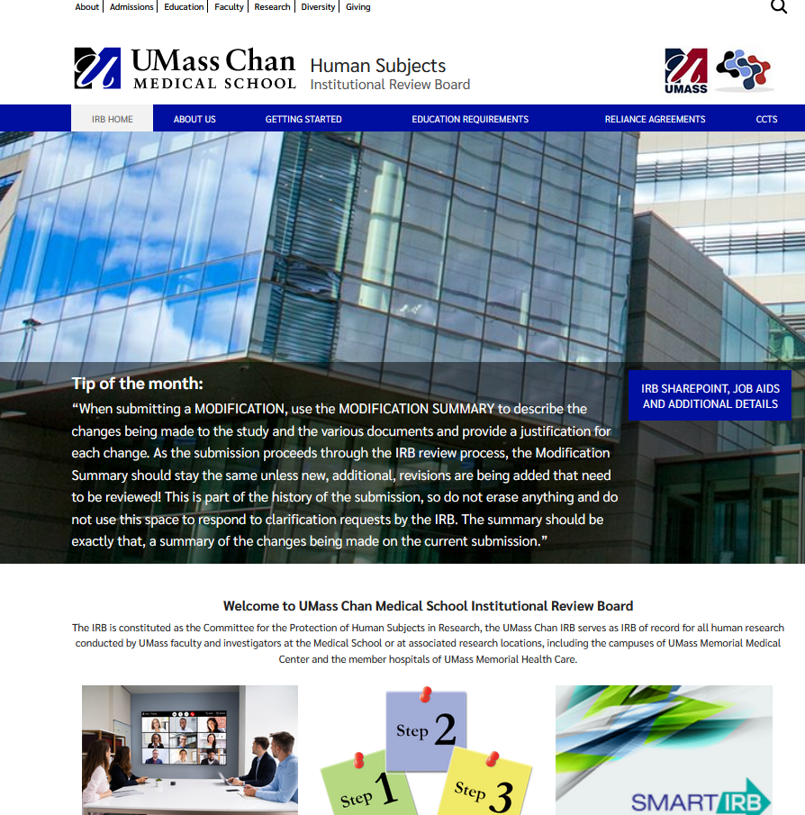
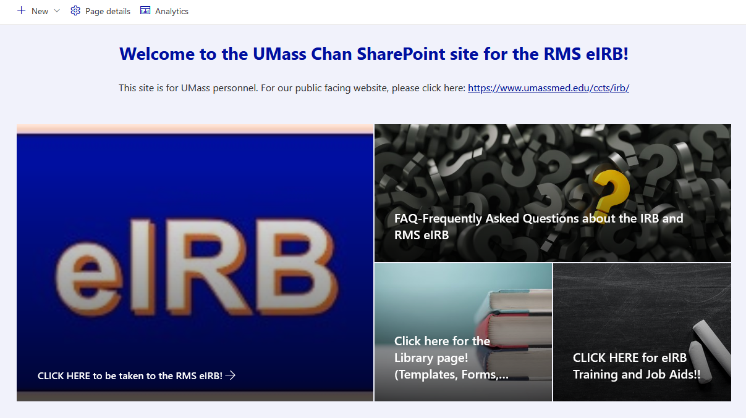
UMass Chan IRB Online Resources
Link to the UMass Chan IRB’s PUBLIC facing website:
https://www.umassmed.edu/ccts/irb/
Direct Link to eIRB Sharepoint website:
https://umassmed.sharepoint.com/sites/RMS/IRB
(NOTE: must log in using umassmed.edu credentials)
Check Back Frequently for Updates!

Slide 37

IRB Public Facing Website https://www.umassmed.edu/ccts/irb/
Link to SharePoint

Slide 38
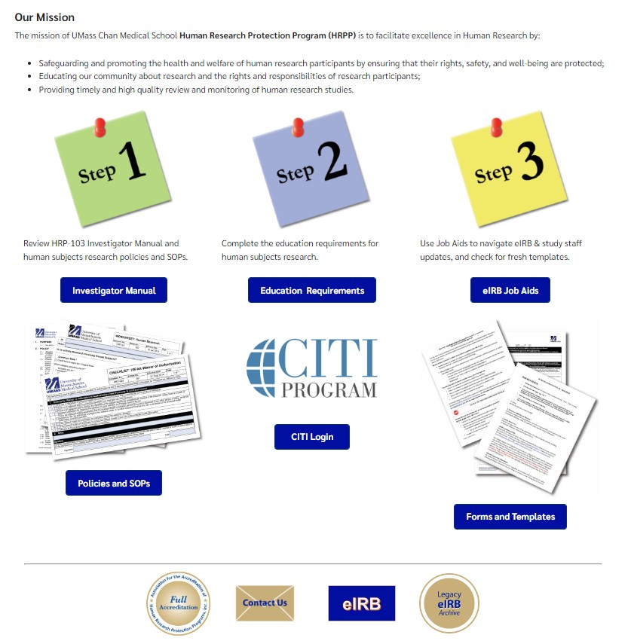
IRB Public Facing Website
Getting Started Page
← Some links will go to SharePoint

Slide 39


Getting Started
Human Subjects: Institutional Review Board
Go to Getting Started on our public website: https://www.umassmed.edu/ccts/irb/getting-started2/
  Read the *Investigator Manual document (HRP-103) and any SOP documents you feel are relevant to your project (click the blue buttons on the webpage to find these documents).
IRB
Step 1
Coordinators & Students
Complete the education requirements for human subjects research found on the CITI program website. A link to CITI can be found on: https://www.umassmed.edu/ccts/irb/getting-started2/
The list of course requirements can be found in our Education Requirements section: https://www.umassmed.edu/ccts/irb/education-requirements/
Step 2
Complete training for the Research Management system (RMS) eIRB Module, found on the *eIRB Sharepoint website: https://umassmed.sharepoint.com/sites/RMS/IRB.
Review at least video courses 1, 2, and 3, and RNI course (review course 4, and PI mini course as needed). Review relevant Job Aids and other materials.
← Some links will go to SharePoint
Step 3
Review relevant forms and templates. For Human Subjects Research (HSR) projects, begin with *Investigator Study Plan (HRP-503). Follow its instructions to see if other documents also need to be reviewed
Other document templates are located on the *eIRB Sharepoint website Library page HERE.
Always use a fresh template when filling out a new document for a study.
Step 4
V1 09.28.22
*UMASSMED.edu email/credentials are required to log in to this site/document.

Slide 40
Mentimeter slide
Has anyone logged into UMass Chan Med School websites before?

Slide 41


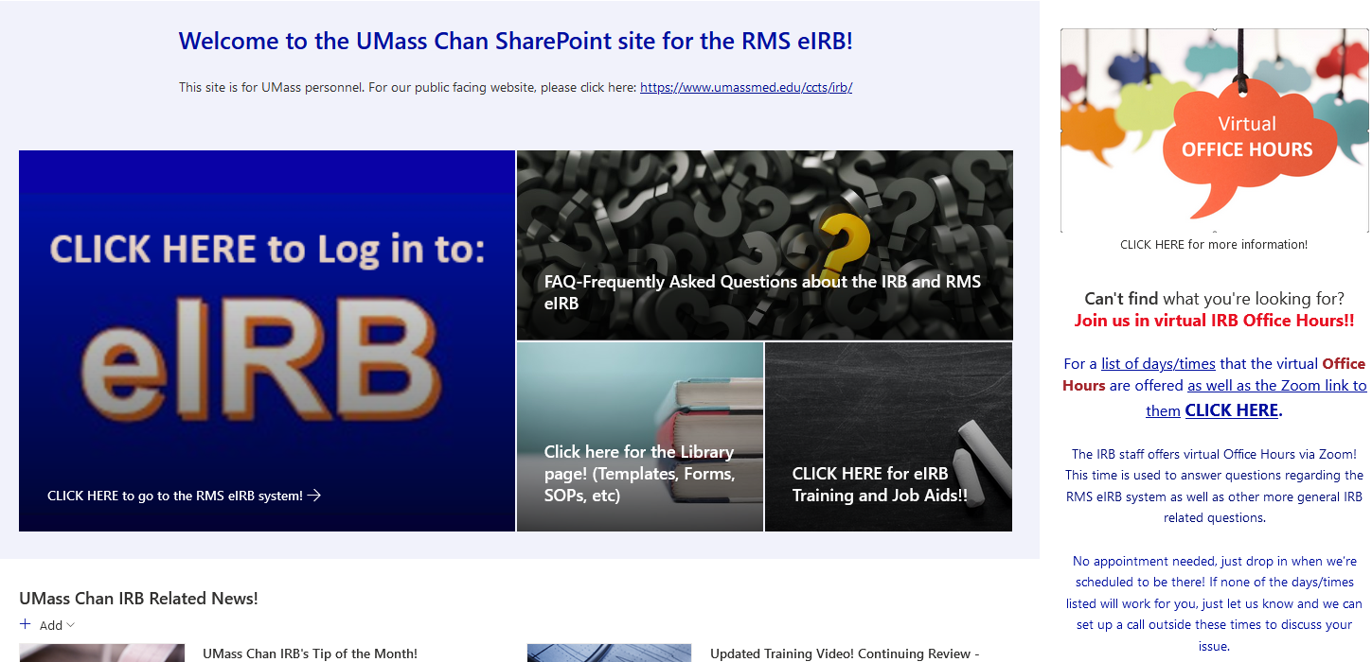
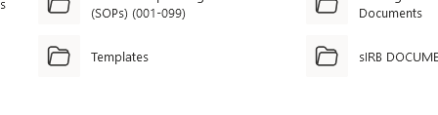
IRB SharePoint Site

Slide 42
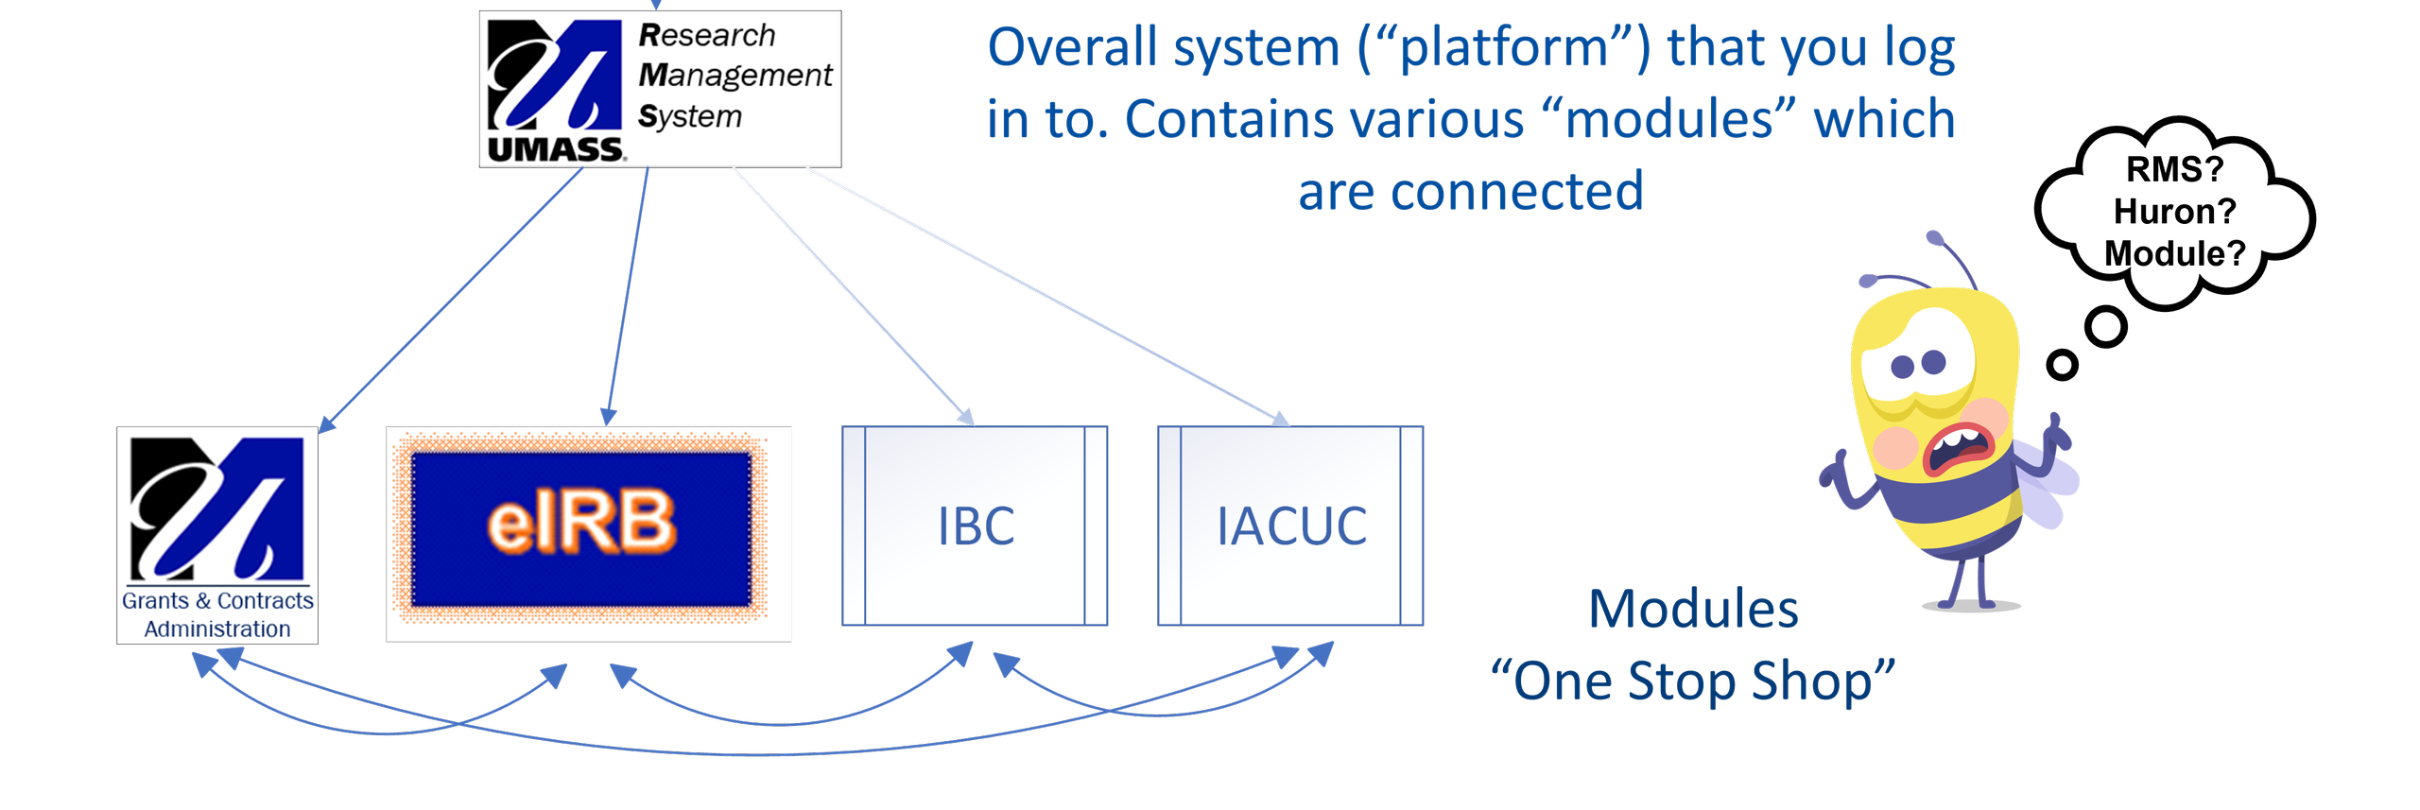
Research Management System Electronic IRB Module
“eIRB”

Slide 43
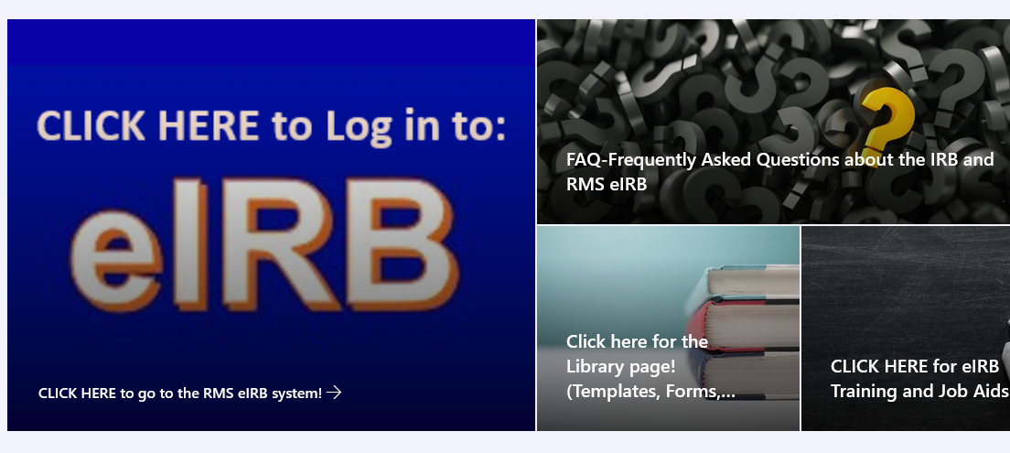
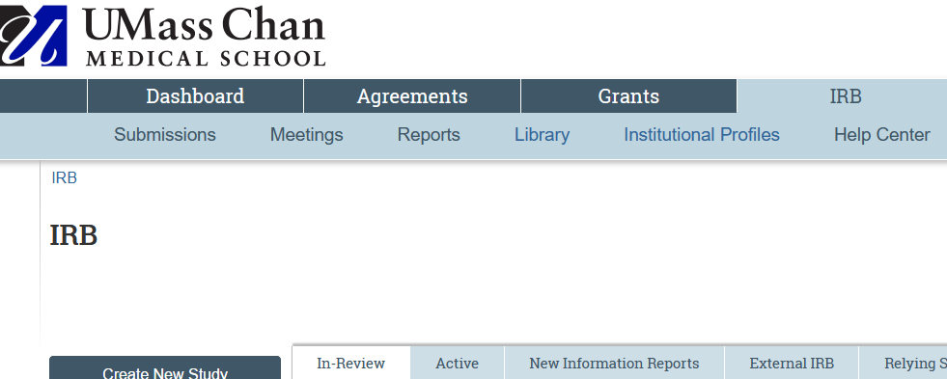
All Items Requiring IRB Review MUST be submitted through the Research Management System electronic IRB module.
RMS eIRB or just eIRB.
https://irb.umassmed.edu/

Slide 44

Be sure to watch the IRB Training videos/Check out relevant Job Aids BEFORE you start your IRB Submission!

Slide 45
General Questions
Any Questions So Far?

Slide 46
The UMass Chan IRB Process
Getting Started with Human Subjects Research at UMass Chan

Slide 47


If your research will involve other institutions, talk to the IRBs about single IRB (sIRB) early on.
A study’s IRB of Record is the IRB assumes full responsibility for review of the study.
IRBs enter into a written agreement for one IRB to serve as IRB of record.
Each institution still collects information needed to maintain oversight of its research.
Each institution still contributes to the review process.
UMass Chan IRB
External IRB
(WCG, Advarra, etc.)

Slide 48
What is the UMass Chan IRB Submission process?
(Not Human Subjects Research vs Human Subjects Research)
Not HSR
Expedited
HSR
Exempt
Full
OR
OR
HRP-503 Investigator Study Plan & other documents
Request for Not HSR Form
Sources: https://www.fda.gov/regulatory-information/search-fda-guidance-documents/institutional-review-boards-frequently-asked-questions#IRBProcedures
https://www.hhs.gov/ohrp/regulations-and-policy/regulations/45-cfr-46/index.html

Slide 49
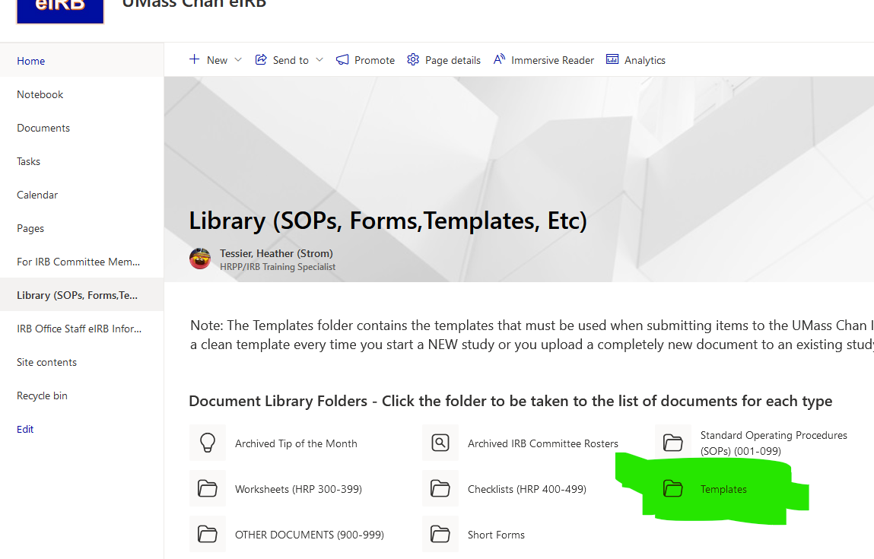
Finding IRB document templates
NOTE: For new studies/brand new documents being created for existing studies, be sure to download the most current template.
Do not recycle forms from other studies.

Slide 50
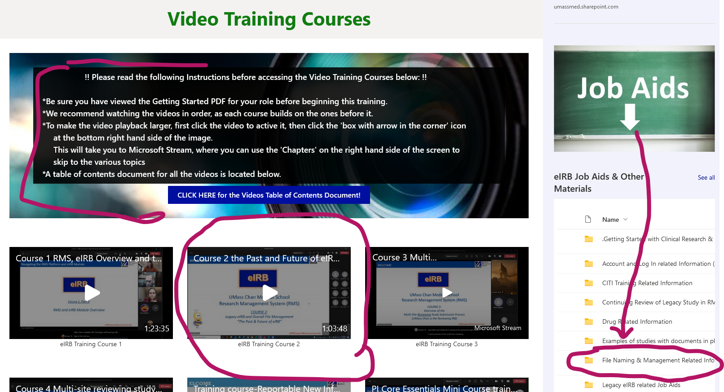
Best Practices for File Management
(Be sure to: Review Video Training Course 2 and Job Aids)

Slide 51
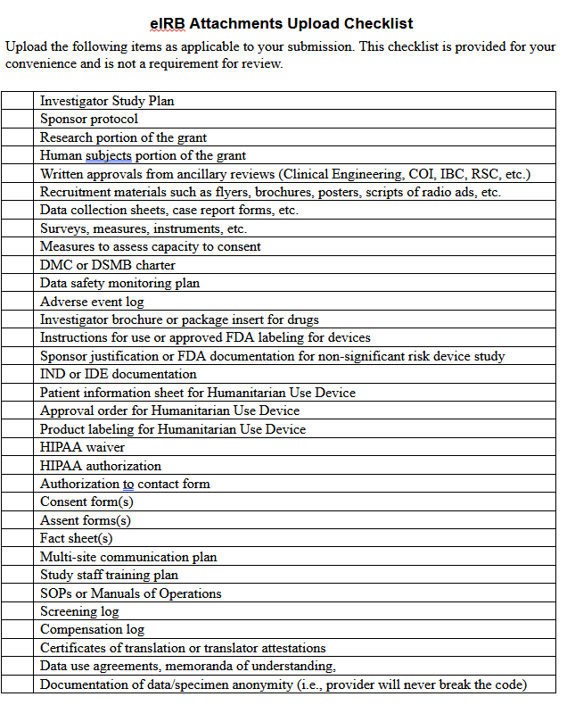
HRP-503 Investigator Study Plan (ISP)
Foundation Document for all HSR where UMass Chan is the IRB of Record
Read and follow the study plan instructions!
  For sections that do not apply to your study, you may write ‘N/A’
Use the checklist at the end of the document to ensure all necessary documents are prepared and uploaded to eIRB
  Some documents templates may be found in the Templates folder on the eIRB SharePoint Library page

Slide 52

Any invitation to participate in research involves a process of informed consent.
IRB will need to review written material that shows the content of that process – a recruitment letter, a script, a consent form, etc.
A subject’s signature is required for:
  Any greater than minimal risk research
  A HIPAA authorization
  Any research with procedures that require a signature outside of the research context.
This Photo by Unknown Author is licensed under CC BY-ND

Slide 53
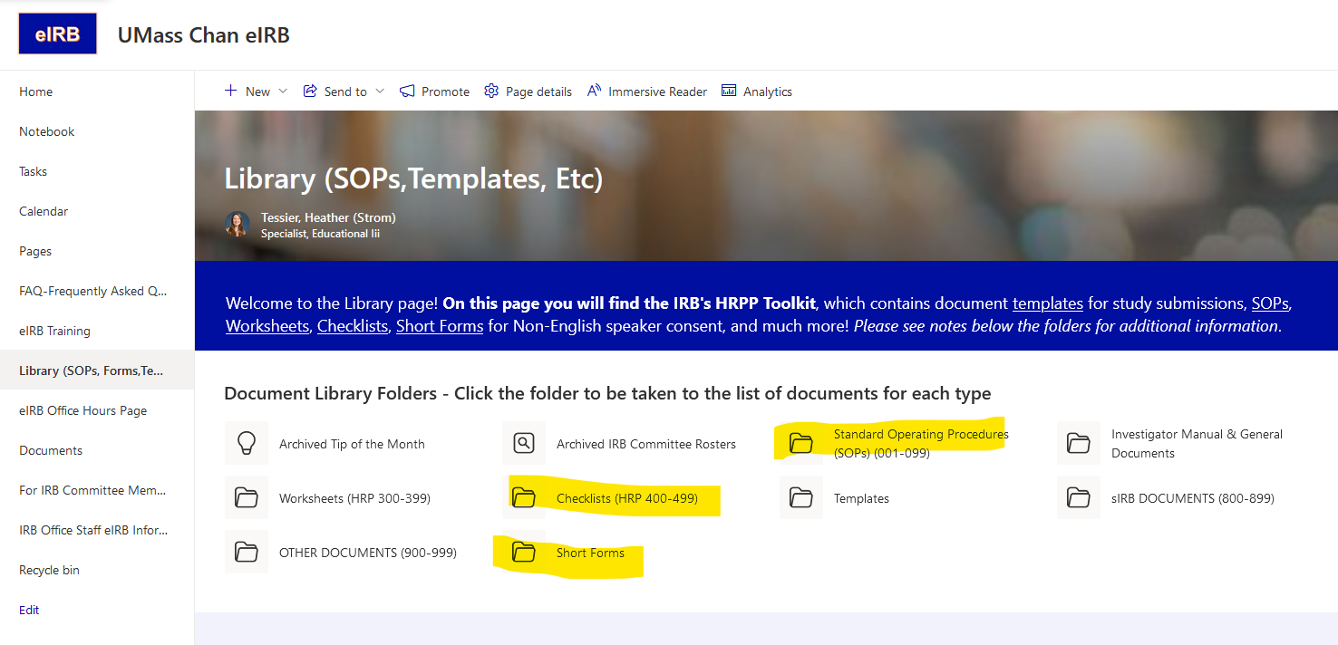
Informed Consent Forms
HRP-503 Investigator Study Plan - Sections #30 and #31 reference the following documents:
HRP-090 SOP: Informed Consent Process for Research
HRP-091 SOP: Written Documentation of Consent.
Short Forms
HRP-410 CHECKLIST: Waiver or Alteration of Consent Process
HRP-502 - Consent Document and HIPAA Authorization template, aka ‘ICF’ or ‘Long Form Consent’ document)
  Used to obtain written documentation of subject’s consent to take part in the study.
  Contains HIPAA Authorization Language
Fact Sheet template – often used to obtain verbal consent from subjects
  Acceptable for studies meeting certain requirements
  Verbal consent should be documented somewhere in the study records.

Slide 54
HIPAA and Human Subjects Research: Brief Intro
Working with Protected Health Information (PHI) means HIPAA documentation is needed!
HRP-503 Investigator Study Plan Section #27 references the following documents:
HIPAA waiver of authorization
HIPAA authorization Stand Alone document
Under the HIPAA Privacy Rule, PHI may be disclosed to Research Staff without an individual’s authorization if the PI obtains approval from an IRB.
  Often done for purposes of Pre-screening for potential subjects or conducting retrospective chart reviews. Must meet certain requirements.
  Fill out and submit HIPAA Waiver of Authorization document to IRB.
Otherwise, subjects must provide written authorization for researcher to access PHI.

Slide 55
General Questions
Any Questions So Far?

Slide 56
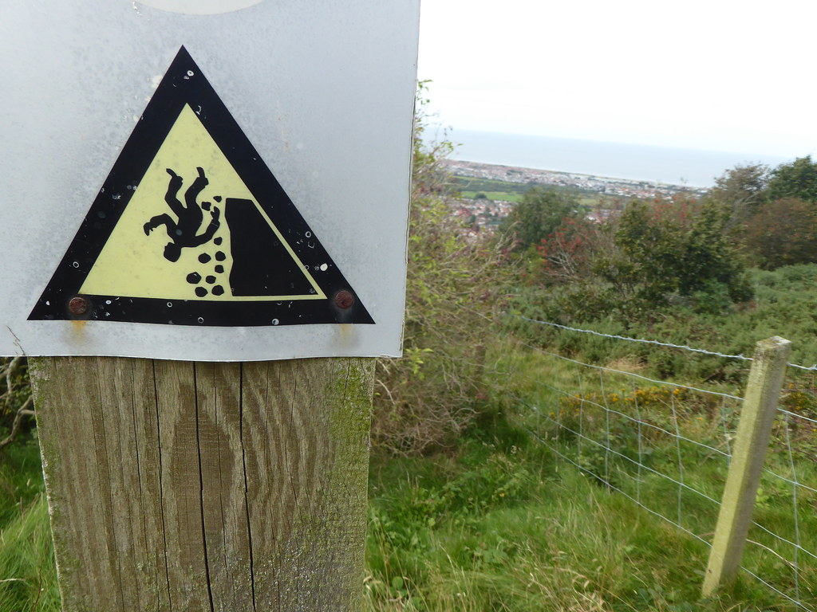
Common Pitfalls to Avoid
This Photo by Unknown Author is licensed under CC BY-SA-NC

Slide 57

Strategies for Success!
This Photo by Unknown Author is licensed under CC BY-NC

Slide 58
Strategies for Success!
Protocol Review Committee
(PRC) &
Other Ancillary Reviews
  IRB Approval may NOT be the only approval you need to obtain before you begin your study!
  Protocol Review Committee (PRC) Review (Dr. Goldberg – Chair)
      Reviews Investigator Initiated studies
        Required for studies that are: 1) >minimal risk to subjects and 2) have not been externally peer reviewed
        Optional (but recommended!) for studies that are <minimal risk to subjects.
      Must be completed BEFORE study is submitted to the IRB!
  Other Ancillary Reviews:
      Conflict of Interest (COI), Radiation Safety Committee (RSC), Institutional Biosafety Committee (IBC), etc.
      Can be done concurrently with IRB review, but IRB cannot grant approval until Ancillary Committee approval is granted.

Slide 59

Strategies for Success!
A GOOD PLAN is EVERYTHING!
Be Sure to Follow Your Approved Investigator Study Plan and use the APPROVED documents!
  Do not make any changes to the study unless they are first approved by the IRB!
Submitted documents almost always should be in their final form
Be mindful when writing up the document of the words ‘will’ and ‘may’
E.g., ‘We will administer a pregnancy test to all females’ vs ‘We will administer a pregnancy to females of childbearing potential with the following exceptions….’
E.g., ‘We WILL draw a CBC at Visit 1’ vs ‘We MAY draw a CBC if medically necessary at Visit 1’.

Slide 60


Strategies for Success!
Be mindful about what data you will collect and might share.
A GOOD PLAN is EVERYTHING!
Data Collection Considerations
What Data, From Where, and Why?
(All about Protecting Subject Privacy)
Take only what you need
        No ‘Fishing’
Don’t Collect What
You Can’t Protect!

Slide 61
A GOOD PLAN is EVERYTHING!
Strategies for Success!
Be mindful about what data you will collect and might share.
Data Sharing Considerations
Think ahead about where you might share your data in order to accurately describe it:
  To the IRB in your study plan.
  To subjects if you will be obtaining consent from them (must be disclosed in Informed Consent Documents).
Some Restrictions May Apply!
For More Best Practices/Other considerations, please see:
  IT Best Practices SharePoint page,
  IRB/Library collaboration video
  HRP-503 ISP template instructions

Slide 62


Strategies for Success!
BUILDING ORGANIZED & CONSISTENT MATERIALS
Menti slide

Slide 63
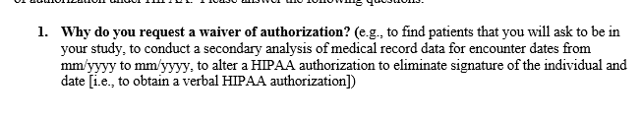
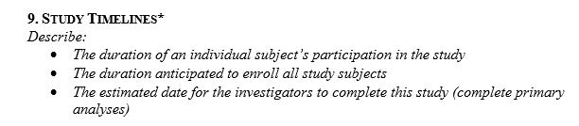
Strategies for Success!
BUILDING ORGANIZED & CONSISTENT MATERIALS
Find and Use the current instructions/templates
Follow File Naming and Version Control best practices
Read the template instructions carefully & be sure to address each point
Tip: Leave instructions in document until fully answered

Slide 64

Strategies for Success!
Build materials that are organized and consistent
Elements of the application must be
Organized and Consistent throughout!
Informed Consent Documents
HIPAA Waiver of Authorization
Investigator Study Plan (ISP)
Cohesive & Complete
Human Subject Research Project
HSR info in Grant Application
Other Documents
Contract
The IRB often has to ask for clarifications because study documents contradict each other!

Slide 65

BUILDING ORGANIZED & CONSISTENT MATERIALS
Strategies for Success!
Proofread!!
Proofread your materials!
Inconsistencies and typos detract from your message and slow down review.
Be careful cutting and pasting from previous documents.
Help the IRB & potential subjects see your application in the best possible light!

Slide 66

Strategies for Success!
Write for Your Intended Audience
IRB
Subjects
  Don’t Assume! Explain clearly and concisely
  Reviewers are scientists & non-scientists
  Participants are not scientists
  Use simple everyday language in consent forms & recruitment materials
Contract
2018 Revised Common Rule: ORHP “…this part of the informed consent must be organized and presented in a way that facilitates comprehension”

Slide 67
General Questions
Any Questions So Far?

Slide 68
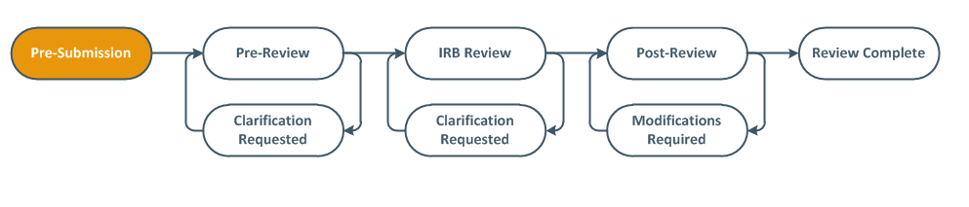
‘Rejected’ by the IRB
IRB Review Process: What to Expect
Begin Submission Here
PI must click the ‘Submit’ button
Work on HSR part of the Study can begin once you have your Approval Letter

Slide 69
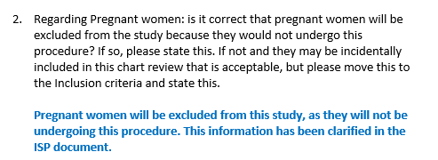

Strategies for Success!
Read Carefully and Follow instructions!
Responding to Clarifications or Modifications requested by the IRB!
Read each point carefully!
Create a point-by-point response where you take each IRB request and answer it (see example above).
Sometimes the IRB will even include suggested wording and placement for changes.
If you don’t agree with or have questions about a request, ASK! (Office Hours are great for this!).

Slide 70

Strategies for Success!
Go to the right place for help!
(Hint: It’s not always the IRB office!)
Your mentor/PI
Proofreaders
NIH pages and instructions: https://grants.nih.gov/grants/how-to-apply-application-guide.html
UMass Chan IT Research Technology
UMass Chan Lamar Soutter Library
UMCCTS Research Informatics Core, Community Engagement, Tissue & Tumor Bank, & more
‘Do Your Homework’ before contacting the IRB
HRP-103 Investigator Manual
  Data retention requirements
  Prompt reporting requirements (to inform data safety monitoring plans)
  Additional federal agency criteria (e.g., DOD funding)
Read instructions & Job Aids, watch training videos

Slide 71

Strategies for Success!
Your Study is IRB Approved!
Now what?
Treat your IRB materials as living documents
Continuing Review of your Study
Check approval letters for expiration dates and set reminders!!
  If one-year or three-year expiration, set a reminder to submit the continuing review
  If no expiration (exempt), set an annual reminder to submit a Modification to close the research once it’s complete
Submit Reportable New Information (RNIs) as required
Modifications to your study after IRB Approval
For non-exempt research obtain prior IRB review and approval for all changes
For exempt research obtain prior IRB review and approval for all changes that involve HIPAA or that potentially change the risks, exemption category, or scope of the research

Slide 72
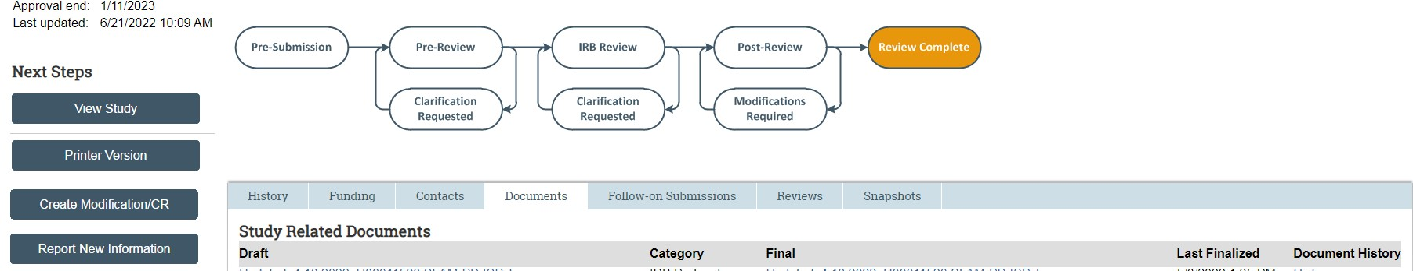
What specifically to consider when submitting a Modification to a project?
Start from the current approved documents in eIRB
When revising an approved document, accept any existing track changes and track only the new changes
Do not convert ‘stamped’ PDFs (ICFs/HIPAA docs) to Word – find the Word version at the parent study
        Summarize the modifications: Provide a description of the changes, a justification for them, and a list of new or revised documents

Slide 73

Strategies for Success!
Submit your items to the IRB
with as much lead time as possible!
Even when processing times were at their best, 30 days start to finish was often the timeframe for Expedited and Full Committee submissions.
The IRB needs AT LEAST 30 days, likely more!
For NIH Just in Time (JIT) grants:
  Please submit to the IRB well before you get grant approval
  1-2 weeks is NOT enough time for the IRB to process the submission.

Slide 74

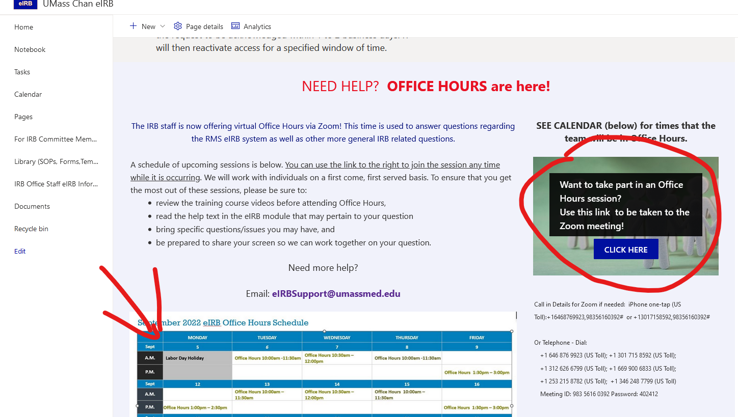

Wrap Up/Questions
Don’t forget about virtual Office Hours!

Slide 75

Thank you!

